Slide 1

The Basics: Hand Hygiene in the Long-Term Care Setting
April 2024
Basic hand hygiene training incorporating activities and discussion for long-term care staff
Notes:
Welcome infection prevention champions! My name is Jen Malewicki and I am a principal planning analyst from the LTC IP program at Hennepin County Public Health. We are so happy to have you with us today as we cover The Basics: Hand Hygiene in the Long-term Care Setting. This training is a basic hand hygiene training intended for long-term care staff that incorporates activities and discussion.

Slide 2
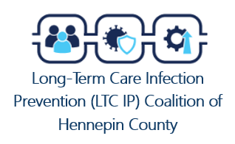

Contributions by:
David Johnson, MPH Hennepin County Public Health
Linn Warnke, RN, MPH, LTC-CIP, CIC
Hennepin County Public Health
Jen Malewicki, BSN, RN Hennepin County Public Health
Caramae Steinwand, BS
Minnesota Department of Health, Project Firstline, ICAR
Pam Powers, RN, ND Minnesota Department of Health, Project Firstline, ICAR
Kari Bergman, BSN, RN, CIC
Minnesota Department of Health, ICAR
LTC.InfectionPrevention@hennepin.us
Notes:
This training was developed by the Long-term Care Infection Prevention Coalition of Hennepin County. Thank you to those listed for your contributions! If you’d like to join this coalition or have questions, please email LTC.InfectionPrevention@hennepin.us

Slide 3
Learning objectives
Upon completion of this training, participants should be able to:
Identify the important moments for hand hygiene in the long-term care setting.
Differentiate when alcohol-based hand sanitizer is preferred and when soap and water is preferred for hand hygiene.
Demonstrate proper hand hygiene technique.
Identify strategies to promote a positive hand hygiene culture.
Notes:
Let’s discuss the learning objectives. Upon completion of this training, participants should be able to:
Identify the important moments for hand hygiene in the long-term care setting.
Differentiate when alcohol-based hand sanitizer is preferred and when soap and water is preferred for hand hygiene.
Demonstrate proper hand hygiene technique.
Identify strategies to promote a positive hand hygiene culture.

Slide 4




Hand hygiene is everyone’s job!
Notes:
As a healthcare worker, you play an extraordinarily important role in preventing the spread of infections and providing safe care to residents. This is true whether you are nursing staff or on the environmental services team. Whether you work in dietary or on the administration team. Each and every role in the long-term care setting has a crucial part in creating and maintaining a healthy and safe resident care environment. Hand hygiene is one of the most important and effective steps a healthcare worker can take to keep residents, staff, and visitors safe and stop the spread of infection.

Slide 5

Why is hand hygiene so important?
The germs that cause multi-drug resistant organisms (MDROs) can be transmitted on the hands of healthcare workers
Hand hygiene is one of the MOST important ways to stop the spread of infection
Too often healthcare workers do not clean their hands. In fact, missed opportunities for hand hygiene can be as high as 50%
65% or 13 out of 20 nursing home residents are colonized with one or more MDRO
(CDC Supported Projects, 2017)
Adapted from CDC, Olmsted, R., Gilmartin, H. M., & Washer, L. (n.d.). Core Concepts for Hand Hygiene: Clean Hands for Healthcare Personnel [Slide show].
Notes:
So why is it that hand hygiene is so important and effective in preventing the spread of infection to residents?
Well, the nature of our work has our hands coming in contact with residents, surfaces, and items in the environment that could have harmful germs on them. Without properly cleaning our hands, those germs can travel to residents, our co-workers and other environmental surfaces.
*click* Some germs that have the biggest threat cause multi-drug resistant organisms, also known as MDROs. *click* According to CDC, 65% of nursing home residents are colonized with one or more MDRO. *click* That means that 13 out of every 20 residents have the harmful germs that cause MDROs and have the ability to spread those germs throughout their daily activities, even if they aren’t actively sick. These germs are extremely hard to treat with medications and can lead to serious illness or even death.
*click* Hand hygiene can prevent those germs from spreading and therefore, is one of the most important steps a healthcare worker can use to keep residents and everyone else in the facility safe. *click* However, despite this awareness, those that observe hand hygiene practices of healthcare workers find that it is missed in 50 percent of opportunities. We can and should do better!
So, what are those important moments for hand hygiene? Well, let’s take a look.
*Speaker notes adapted from CDC Core Concepts for Hand Hygiene: Clean Hands for Healthcare Personnel
https://www.bing.com/ck/a?!&&p=6140439f92b5efbbJmltdHM9MTcwMTA0MzIwMCZpZ3VpZD0xMDM1ZjgzZS0xYzM1LTZiOWItMWM4Yi1lYTlhMWQ1NzZhMmQmaW5zaWQ9NTIyMg&ptn=3&ver=2&hsh=3&fclid=1035f83e-1c35-6b9b-1c8b-ea9a1d576a2d&psq=core+concepts+for+hand+hygiene&u=a1aHR0cHM6Ly93d3cuY2RjLmdvdi9pbmZlY3Rpb25jb250cm9sL3BkZi9zdHJpdmUvSEgxMDEtNTA4LnBkZg&ntb=1

Slide 6
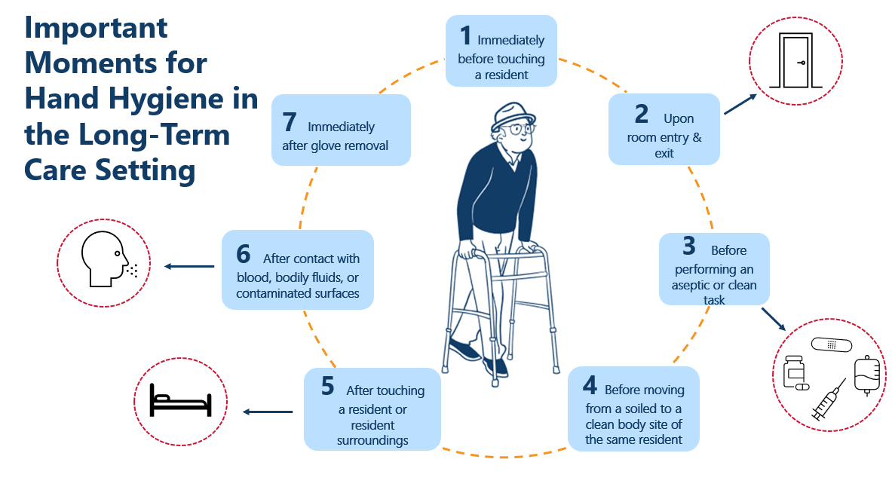
Adapted from Your Five Moments for Hand Hygiene. (2009, May). World Health Organization. Retrieved November 29, 2023.
Notes:
We have identified 7 important moments for hand hygiene in the long-term care setting. These include
Immediately before touching a resident,
Upon room entry & exit
Before performing an aseptic or clean task
Before moving from a soiled to a clean body site of the same resident
After touching a resident or resident surroundings
After contact with blood, bodily fluids, or contaminated surfaces
Immediately after glove removal
Speaker notes from CDC Core Concepts for Hand Hygiene: Clean Hands for Healthcare Personnel

Slide 7
1 | Immediately before touching a resident | WHY? | To protect the resident from harmful germs that may be on your hands
2 | Upon room entry & exit | WHY? | To protect the resident and the resident’s environment from harmful germs upon entry and to protect the rest of the healthcare environment upon exit
3 | Before performing an aseptic or clean task | WHY? | To protect the resident from harmful germs, including the resident’s own, from entering their body (i.e., injection administration, catheter care, wound care)
4 | Before moving from a soiled to a clean body site of the same resident | WHY? | To protect the resident from harmful germs that may have been present on the soiled body site and prevent it from entering the clean body site
5 | After touching a resident or resident surroundings | WHY? | To protect yourself and the healthcare environment from harmful germs the resident may have
6 | After contact with blood, bodily fluids, or contaminated surfaces | WHY? | To protect yourself and the healthcare environment from harmful germs the resident may have in their blood, bodily fluids, and contaminated surfaces.
7 | Immediately after glove removal | WHY? | To protect yourself and the healthcare environment from harmful germs. Germs from your gloves may have gotten on your hands during glove removal!
Adapted from Your Five Moments for Hand Hygiene. (2009, May). World Health Organization. Retrieved November 29, 2023.
Notes:
Who is being protected after you perform hand hygiene? Well, it varies with each hand hygiene moment. Let’s dive deeper into when and why we clean our hands at each moment.
We clean our hands immediately before touching a resident because we want to protect the resident from harmful germs that may be on our hands.
We clean our hands upon room entry to protect the resident and resident’s environment from harmful germs and we clean our hands upon exit to protect the rest of the healthcare environment.
We clean our hands before performing an aseptic or clean task (such as administering medication or an injection, providing catheter or wound care, med pass) to protect the resident from harmful germs entering their body.
We clean our hands before moving from a soiled to a clean body site of the same resident to protect the resident from harmful germs that may have been present on the soiled body site and prevent it from entering the clean body site.
We clean our hands after touching a resident or resident surroundings to protect ourselves from harmful germs that the resident may have and prevent spreading harmful germs to the healthcare environment.
We clean our hands after contact with blood, bodily fluids, and contaminated surfaces to protect ourselves from harmful germs that the resident may have and prevent spreading harmful germs to the healthcare environment.
We clean our hands immediately after glove removal to protect ourselves from harmful germs that the resident may have and prevent spreading harmful germs to the healthcare environment. Germs from your gloves may have gotten on your hands during glove removal!

Slide 8
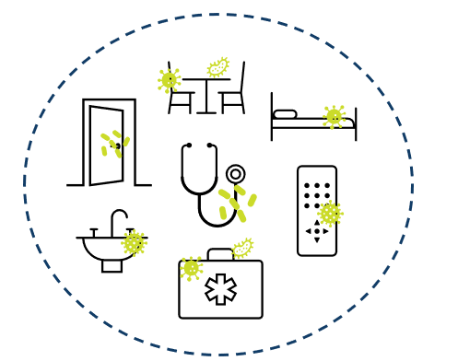
Environmental surfaces can look clean but…
Germs can survive for days on resident care equipment and other surfaces like bed rails, medical equipment, etc.
It is important to use hand hygiene after touching these surfaces and at exit, even if you only touched environmental surfaces
Adapted from CDC, Olmsted, R., Gilmartin, H. M., & Washer, L. (n.d.). Core Concepts for Hand Hygiene: Clean Hands for Healthcare Personnel [Slide show).
Notes:
Don’t be fooled by a surface that may look clean…
*Click* Environmental surfaces immediately around or near the resident can look clean but often are contaminated with germs. The environmental services team works hard to keep high touch surface areas clean, but it would be impossible to have these items free of germs 100% of the time. *Click* As healthcare workers touch surfaces, germs can be picked up on their hands and without proper hand hygiene, can spread to the next task, resident, or surface in the healthcare environment. Therefore, it is important to remember this moment for hand hygiene and clean hands after touching environmental surfaces near the resident including the over-bed table, equipment, workstations on wheels, etc., even if the surfaces look clean.
*Speaker notes adapted from CDC Core Concepts for Hand Hygiene: Clean Hands for Healthcare Personnel
https://www.bing.com/ck/a?!&&p=6140439f92b5efbbJmltdHM9MTcwMTA0MzIwMCZpZ3VpZD0xMDM1ZjgzZS0xYzM1LTZiOWItMWM4Yi1lYTlhMWQ1NzZhMmQmaW5zaWQ9NTIyMg&ptn=3&ver=2&hsh=3&fclid=1035f83e-1c35-6b9b-1c8b-ea9a1d576a2d&psq=core+concepts+for+hand+hygiene&u=a1aHR0cHM6Ly93d3cuY2RjLmdvdi9pbmZlY3Rpb25jb250cm9sL3BkZi9zdHJpdmUvSEgxMDEtNTA4LnBkZg&ntb=1
https://www.bing.com/ck/a?!&&p=6140439f92b5efbbJmltdHM9MTcwMTA0MzIwMCZpZ3VpZD0xMDM1ZjgzZS0xYzM1LTZiOWItMWM4Yi1lYTlhMWQ1NzZhMmQmaW5zaWQ9NTIyMg&ptn=3&ver=2&hsh=3&fclid=1035f83e-1c35-6b9b-1c8b-ea9a1d576a2d&psq=core+concepts+for+hand+hygiene&u=a1aHR0cHM6Ly93d3cuY2RjLmdvdi9pbmZlY3Rpb25jb250cm9sL3BkZi9zdHJpdmUvSEgxMDEtNTA4LnBkZg&ntb=1

Slide 9
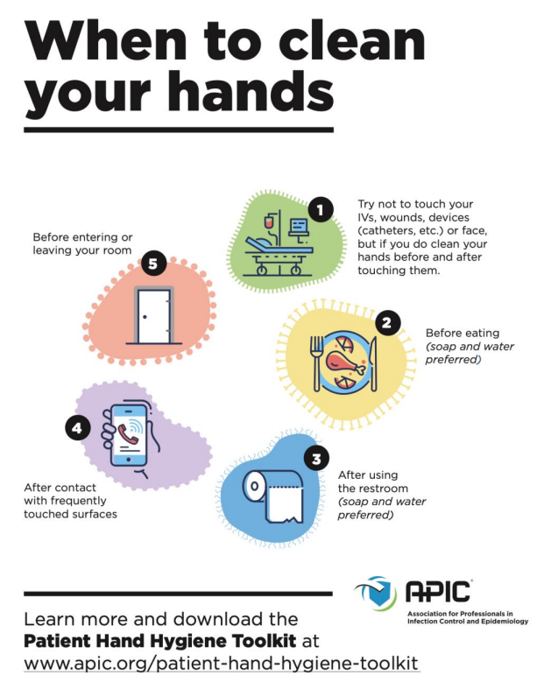
Partnering with residents for hand hygiene
Healthcare workers should encourage residents, families and visitors to clean their hands.
Consider encouraging the following hand hygiene moments listed to the right.
Adapted from CDC, Olmsted, R., Gilmartin, H. M., & Washer, L. (n.d.). Core Concepts for Hand Hygiene: Clean Hands for Healthcare Personnel [Slide show].
Notes:
Residents play a big role in hand hygiene efforts, too. *click* It is important to encourage them, their families, and visitors to use best hand hygiene practices. As healthcare workers we should ensure that residents and visitors have access to proper hand hygiene supplies like alcohol-based hand sanitizer, disposable wipes, and soap available at their sink.
While residents and family are aware of the importance of hand hygiene, this is often not reinforced during their time of stay.*Click* Consider encouraging the following hand hygiene moments:
Before and after touching IVs, wounds, devices or face
Before eating (soap and water preferred)
After using the restroom (soap and water preferred)
After contact with frequently touched items (cell phones, railings, remote controls)
Before entering or leaving the room
*Speaker notes adapted from CDC Core Concepts for Hand Hygiene: Clean Hands for Healthcare Personnel
https://www.bing.com/ck/a?!&&p=6140439f92b5efbbJmltdHM9MTcwMTA0MzIwMCZpZ3VpZD0xMDM1ZjgzZS0xYzM1LTZiOWItMWM4Yi1lYTlhMWQ1NzZhMmQmaW5zaWQ9NTIyMg&ptn=3&ver=2&hsh=3&fclid=1035f83e-1c35-6b9b-1c8b-ea9a1d576a2d&psq=core+concepts+for+hand+hygiene&u=a1aHR0cHM6Ly93d3cuY2RjLmdvdi9pbmZlY3Rpb25jb250cm9sL3BkZi9zdHJpdmUvSEgxMDEtNTA4LnBkZg&ntb=1

Slide 10

Empowering residents to speak up
Encourage residents to not be afraid to use their voice -that it’s ok to ask their healthcare provider questions, such as:
“I didn’t see you clean your hands when you came in, would you mind cleaning them again before you examine me?”
“I’m worried about germs spreading in the facility. Will you please clean your hands once more before you start my treatment?”
Notes:
We should also partner with residents and family members to encourage them to help us remember to clean our hands. Their voices are very important and it is worth sharing with residents that we welcome their hand hygiene reminders when we are taking care of them. You can suggest that they offer statements like:
*Click* “I didn’t see you clean your hands when you came in, would you mind cleaning them again before you examine me?” or
*Click* “I’m worried about germs spreading in the facility. Will you please clean your hands once more before you start my treatment?”
Now let’s learn more about the different methods of hand hygiene.
*Speaker notes adapted from CDC Core Concepts for Hand Hygiene: Clean Hands for Healthcare Personnel
https://www.bing.com/ck/a?!&&p=6140439f92b5efbbJmltdHM9MTcwMTA0MzIwMCZpZ3VpZD0xMDM1ZjgzZS0xYzM1LTZiOWItMWM4Yi1lYTlhMWQ1NzZhMmQmaW5zaWQ9NTIyMg&ptn=3&ver=2&hsh=3&fclid=1035f83e-1c35-6b9b-1c8b-ea9a1d576a2d&psq=core+concepts+for+hand+hygiene&u=a1aHR0cHM6Ly93d3cuY2RjLmdvdi9pbmZlY3Rpb25jb250cm9sL3BkZi9zdHJpdmUvSEgxMDEtNTA4LnBkZg&ntb=1

Slide 11
Hand hygiene methods
Hand hygiene applies to the use of either alcohol-based hand sanitizer or soap and water.
Alcohol-based hand sanitizer: rubbing hands with an alcohol containing hand hygiene product
  Ensure alcohol concentration is above 60%
Handwashing: washing hands with soap & water
Adapted from CDC, Olmsted, R., Gilmartin, H. M., & Washer, L. (n.d.). Core Concepts for Hand Hygiene: Clean Hands for Healthcare Personnel [Slide show].
Notes:
There are two main methods healthcare workers can use to clean their hands: using an alcohol-based hand sanitizer or washing hands with soap and water.
Alcohol-based hand sanitizer can be used for most situations. The alcohol-based hand sanitizer should have at least a 60% alcohol concentration.
An antimicrobial soap is often provided in healthcare facilities for routine handwashing.
*Speaker notes adapted from CDC Core Concepts for Hand Hygiene: Clean Hands for Healthcare Personnel
https://www.bing.com/ck/a?!&&p=6140439f92b5efbbJmltdHM9MTcwMTA0MzIwMCZpZ3VpZD0xMDM1ZjgzZS0xYzM1LTZiOWItMWM4Yi1lYTlhMWQ1NzZhMmQmaW5zaWQ9NTIyMg&ptn=3&ver=2&hsh=3&fclid=1035f83e-1c35-6b9b-1c8b-ea9a1d576a2d&psq=core+concepts+for+hand+hygiene&u=a1aHR0cHM6Ly93d3cuY2RjLmdvdi9pbmZlY3Rpb25jb250cm9sL3BkZi9zdHJpdmUvSEgxMDEtNTA4LnBkZg&ntb=1

Slide 12
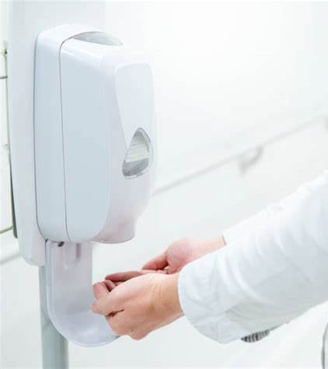
Which method is preferred?
In most situations, using an alcohol-based hand sanitizer is the most effective method for hand hygiene.
Benefits of alcohol-based hand sanitizer:
Requires less time
Reduces germ counts on hands
More accessible than sinks
Improves skin condition
Notes:
So which method is preferred? In most situations, using an alcohol-based hand sanitizer is the most effective method for hand hygiene. Compared to soap and water, alcohol-based hand sanitizer is more effective at reducing germs on the hands and it’s effective against MDROs. Additionally, alcohol-based hand sanitizers can cause less skin irritation than frequent use of soap and water.
The benefits of using alcohol-based hand sanitizer include:
*click* it takes less time to clean your hands
*click* it is more effective against most germs on the skin
*click* can be more accessible than having to find a handwashing sink and
*click* actually improves skin condition as many hand sanitizers contain moisturizers.
*Speaker notes adapted from CDC Core Concepts for Hand Hygiene: Clean Hands for Healthcare Personnel
https://www.bing.com/ck/a?!&&p=6140439f92b5efbbJmltdHM9MTcwMTA0MzIwMCZpZ3VpZD0xMDM1ZjgzZS0xYzM1LTZiOWItMWM4Yi1lYTlhMWQ1NzZhMmQmaW5zaWQ9NTIyMg&ptn=3&ver=2&hsh=3&fclid=1035f83e-1c35-6b9b-1c8b-ea9a1d576a2d&psq=core+concepts+for+hand+hygiene&u=a1aHR0cHM6Ly93d3cuY2RjLmdvdi9pbmZlY3Rpb25jb250cm9sL3BkZi9zdHJpdmUvSEgxMDEtNTA4LnBkZg&ntb=1

Slide 13
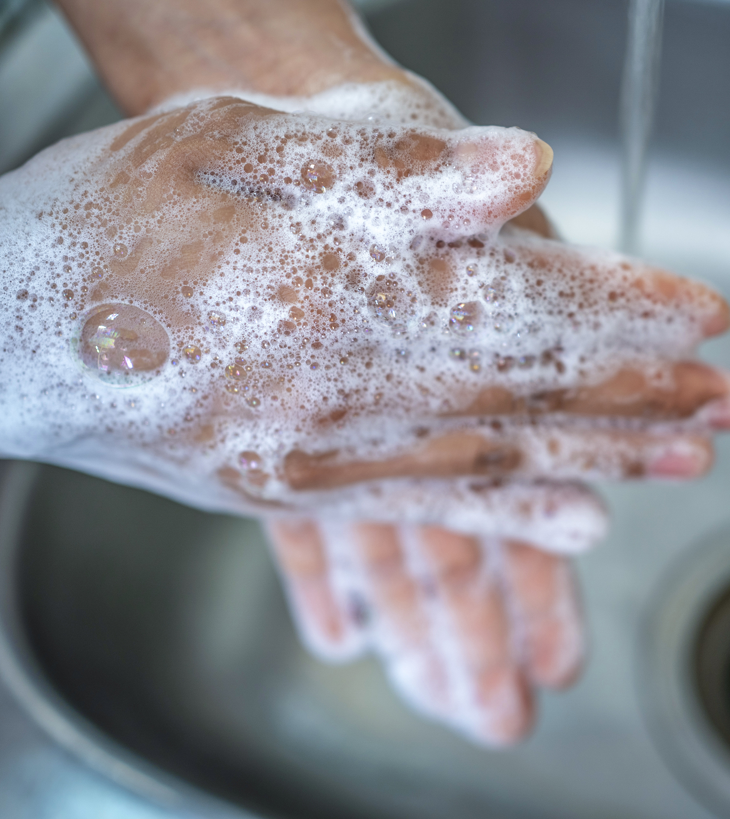
Handwashing with soap and water should be used when:
Hands are visibly dirty
After using the restroom
Before eating
Caring for a resident with uncontained stool, Clostridioides difficile (C. diff) or Norovirus
Notes:
Although hand sanitizer is preferred most of the time, there are some circumstances where washing hands with soap and water is preferred. Those include:
When hands are visibly dirty
After using the restroom
Before eating
When caring for a resident uncontained stool or with infections like Clostridioides difficile (otherwise known as C. diff) or Norovirus
*Speaker notes adapted from CDC Core Concepts for Hand Hygiene: Clean Hands for Healthcare Personnel
https://www.bing.com/ck/a?!&&p=6140439f92b5efbbJmltdHM9MTcwMTA0MzIwMCZpZ3VpZD0xMDM1ZjgzZS0xYzM1LTZiOWItMWM4Yi1lYTlhMWQ1NzZhMmQmaW5zaWQ9NTIyMg&ptn=3&ver=2&hsh=3&fclid=1035f83e-1c35-6b9b-1c8b-ea9a1d576a2d&psq=core+concepts+for+hand+hygiene&u=a1aHR0cHM6Ly93d3cuY2RjLmdvdi9pbmZlY3Rpb25jb250cm9sL3BkZi9zdHJpdmUvSEgxMDEtNTA4LnBkZg&ntb=1

Slide 14

Skin and hand condition
Healthy skin is less likely to permit growth of germs
Lotions should be compatible with hand sanitizer, soap, and gloves
  Petroleum-based lotion formulations can weaken latex gloves
Keep fingernails short – refer to your facility’s policy on artificial nails and polish
Notes:
An important consideration when talking about hand hygiene is the condition of your skin and hands. Healthy skin is less likely to permit growth of germs that may be picked up during resident care. Therefore, lotions that are compatible with hand sanitizer or soap should be provided to keep your skin moisturized and healthy. Petroleum-based lotion formulations can weaken latex gloves and increase permeability. Lotions that contain petroleum or other oil emollients should only be used at the end of the workday.
Your fingernail length and condition is also important. Generally speaking, it is best to keep fingernails short. Make sure to check with your facility’s policy regarding fingernail length and consideration around artificial nails and polish.
*Speaker notes adapted from CDC Core Concepts for Hand Hygiene: Clean Hands for Healthcare Personnel
https://www.bing.com/ck/a?!&&p=6140439f92b5efbbJmltdHM9MTcwMTA0MzIwMCZpZ3VpZD0xMDM1ZjgzZS0xYzM1LTZiOWItMWM4Yi1lYTlhMWQ1NzZhMmQmaW5zaWQ9NTIyMg&ptn=3&ver=2&hsh=3&fclid=1035f83e-1c35-6b9b-1c8b-ea9a1d576a2d&psq=core+concepts+for+hand+hygiene&u=a1aHR0cHM6Ly93d3cuY2RjLmdvdi9pbmZlY3Rpb25jb250cm9sL3BkZi9zdHJpdmUvSEgxMDEtNTA4LnBkZg&ntb=1

Slide 15
The power of hand hygiene
Panel A (left): Culture of healthcare personnel’s hand following ungloved abdominal exam of a patient –colonized with methicillin-resistant S. aureus(MRSA)
Panel B (right): Same personnel’s hand after application of alcohol-based hand sanitizer.
(Donskey CJ, N Engl J Med, 2009)
Adapted from CDC, Olmsted, R., Gilmartin, H. M., & Washer, L. (n.d.). Core Concepts for Hand Hygiene: Clean Hands for Healthcare Personnel [Slide show].
Notes:
Now let’s look at a study from Donskey and others that showed the concentration of MRSA (an MDRO) detected on hands of a healthcare worker after providing a simple abdominal exam of a person who was colonized in the nose with MRSA.
After the exam, the healthcare worker pressed his hand onto culture plate without performing hand hygiene. This person then applied alcohol-based hand rub and pressed their clean hand onto another culture plate.
Following incubation, the plate on the left, where hand hygiene wasn’t performed, had close to a billion germs! On the right you can see that there is almost a total removal of MRSA from the hand after using alcohol-based hand sanitizer.
This demonstrates how effective hand hygiene can be in preventing the spread of germs.
*Speaker notes adapted from CDC Core Concepts for Hand Hygiene: Clean Hands for Healthcare Personnel
https://www.bing.com/ck/a?!&&p=6140439f92b5efbbJmltdHM9MTcwMTA0MzIwMCZpZ3VpZD0xMDM1ZjgzZS0xYzM1LTZiOWItMWM4Yi1lYTlhMWQ1NzZhMmQmaW5zaWQ9NTIyMg&ptn=3&ver=2&hsh=3&fclid=1035f83e-1c35-6b9b-1c8b-ea9a1d576a2d&psq=core+concepts+for+hand+hygiene&u=a1aHR0cHM6Ly93d3cuY2RjLmdvdi9pbmZlY3Rpb25jb250cm9sL3BkZi9zdHJpdmUvSEgxMDEtNTA4LnBkZg&ntb=1

Slide 16
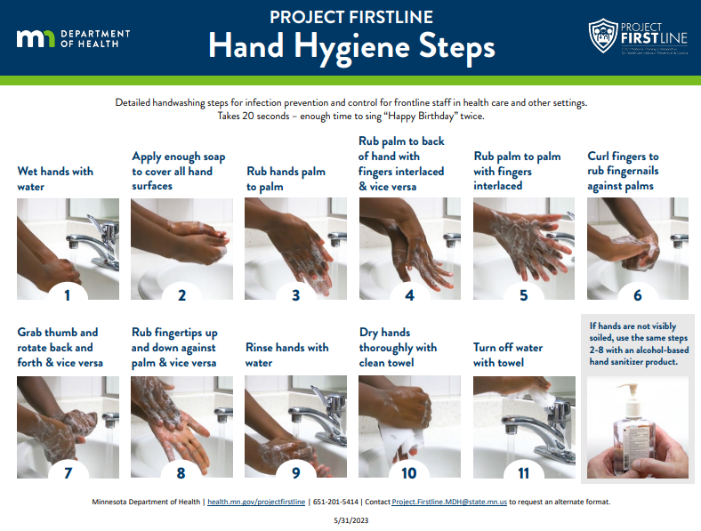
Image from Project Firstline Hand Hygiene Steps. (2023, May).
Notes:
We’ve discussed the importance, the methods, and effectiveness of hand hygiene. Now let’s talk about technique. Performing hand hygiene properly is essential in order to prevent the spread of germs. It’s important that we get all of the surfaces on our hands. Handwashing should take at least 20 seconds – enough time to sing “Happy Birthday” twice and it starts with
Wetting hands with water
Applying enough soap to cover all hand surfaces
Rubbing hands palm to palm
Rubbing palm to back of hand with fingers interlaces and vice versa
Rubbing palm to palm with fingers interlaced
Curling fingers to rub fingernails against palms
Grabbing thumb and rotating back and forth and vice versa
Rubbing fingertips up and down against palm
Rinsing hands with water
Drying hands thoroughly with a clean towel
Turning of the water with the towel
If hands are not visibly dirty, and using an alcohol-based hand sanitizer, you would follow steps 2-8.

Slide 17
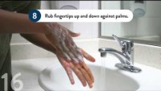
How to wash your hands video
Notes:
Let’s watch the proper technique in action.

Slide 18

Activity – time to demonstrate your knowledge!
Notes:
Now it’s your turn to demonstrate your knowledge on hand hygiene technique! We will be using a fluorescent germ indicator gel or lotion. This material can be applied like soap or hand sanitizer. You can’t see where the material is until a blacklight is shined on it.

Slide 19
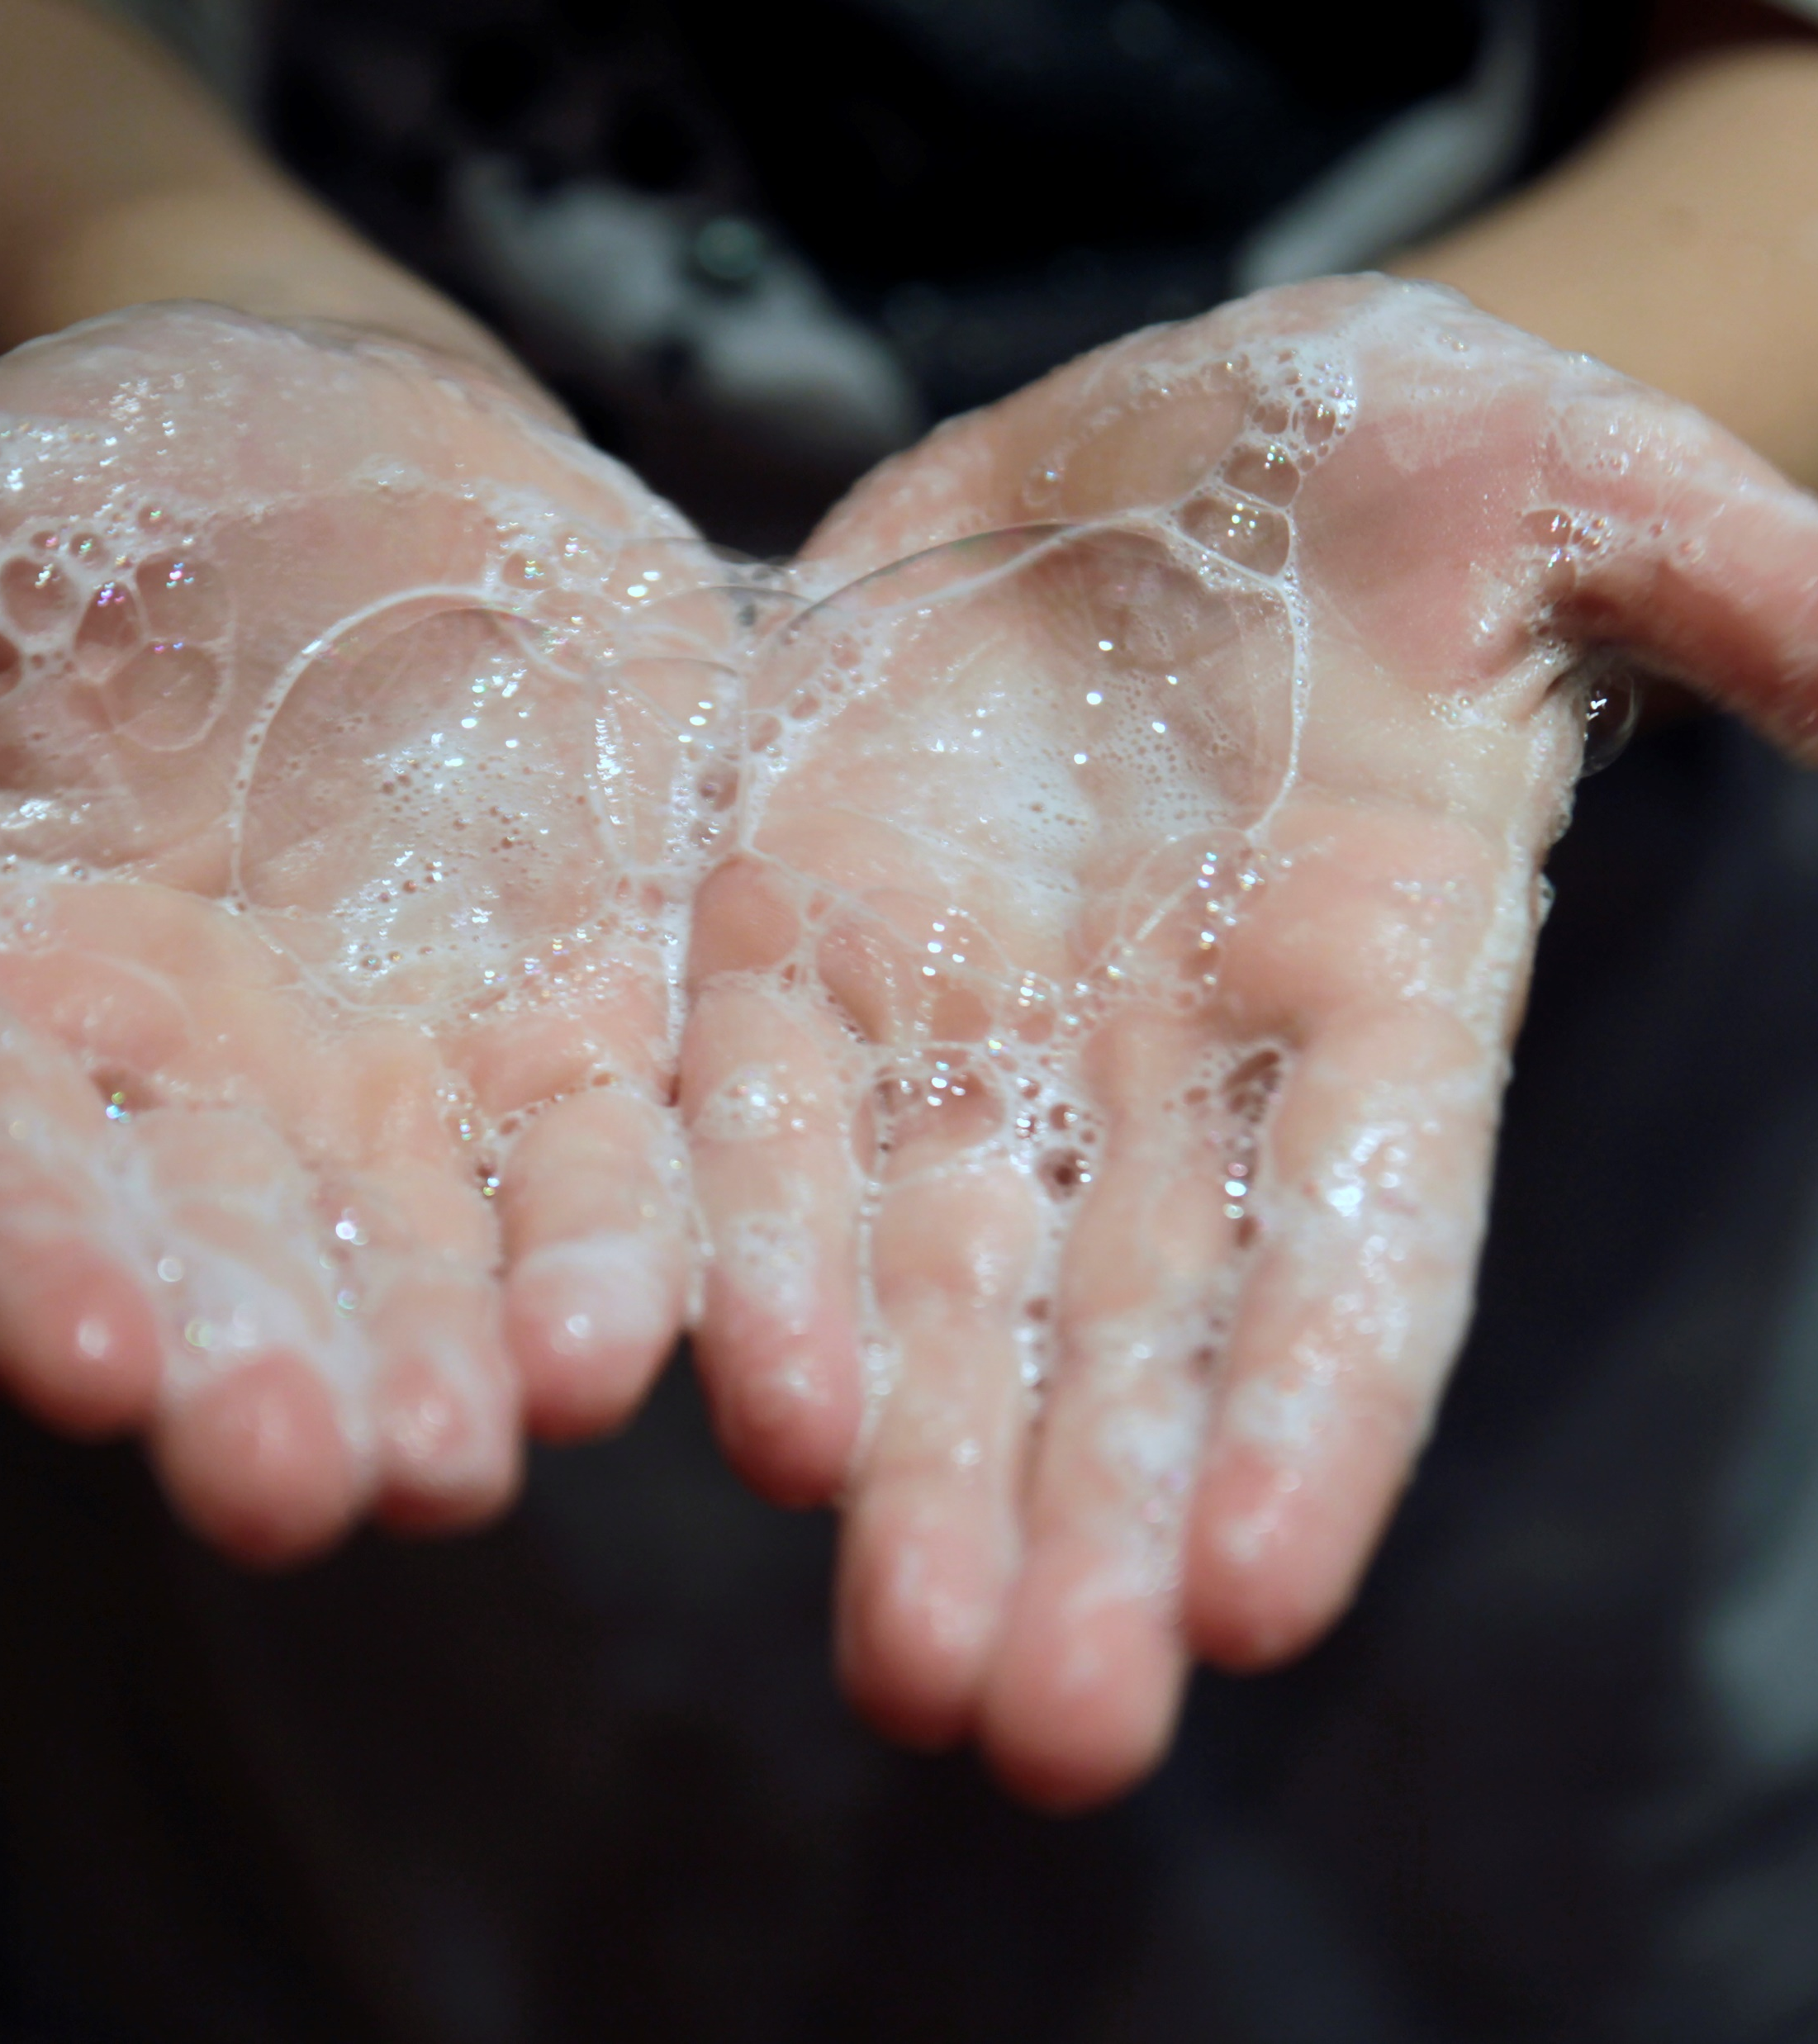
Instructions
Apply clean gloves
Apply the fluorescent germ indicator gel or lotion to hands
Rub your hands together as you would if you were handwashing or using hand sanitizer.
Use black light to identify any missed areas
Doff gloves
Notes:
For this activity, we will do the following:
Apply clean gloves
Apply the fluorescent germ indicator gel or lotion to hands
Rub your hands together as you would if you were handwashing or using hand sanitizer.
Use black light to identify any missed areas
Remove and throw away gloves
*Pause the recording for 5-10 minutes to complete this activity, then return to the recording*

Slide 20

Let’s take a moment to rewind and think…
Did you contaminate yourself while doffing gloves?
Use the blacklight to see where you may have contaminated your skin by removing gloves.
Remember – always perform hand hygiene after doffing gloves!
Notes:
Let’s take a moment to rewind and think…
Did you contaminate yourself while taking off your gloves?
Use the blacklight to see where you may have contaminated your skin by removing gloves.
Remember – always perform hand hygiene after glove removal!

Slide 21
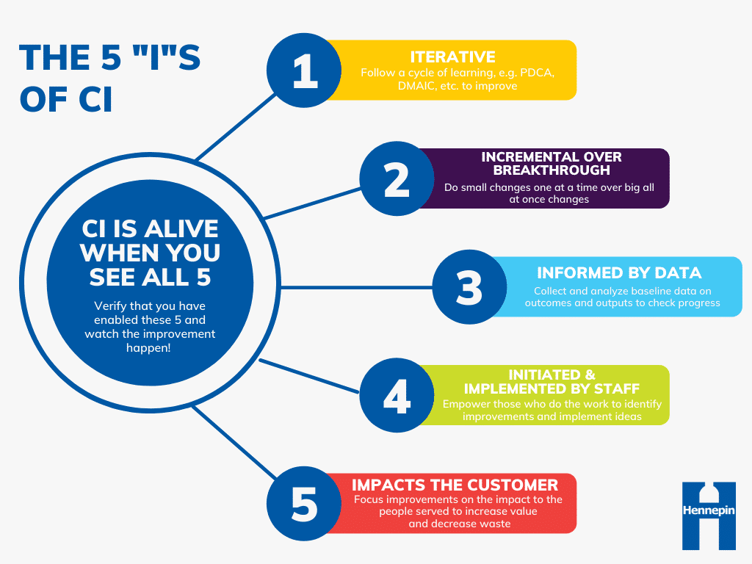
Promoting a positive hand hygiene culture
Notes:
Hand hygiene is part of everyone’s role in the long-term care setting! To promote a positive culture around hand hygiene, it is important that the program is efficient in addition to staff feeling supported and held accountable.
*click* The 5 “I”s of continuous improvement is a great tool to consider when looking to improve hand hygiene practices. The 5 concepts are:
Iterative – meaning that the practice can be applied repeatedly, or it follows a cycle
Incremental over breakthrough – small changes one at a time over big changes all at once
Informed by data – collect & analyze baseline data on outcomes and outputs to check progress
Initiated and implemented by staff – empower those who do the work to identify improvements and implement ideas
Impacts the customer – focus improvements on the impact to the people served

Slide 22

Promoting a positive hand hygiene culture
Audits are ways to review and evaluate practices
Audit data is calculated into a hand hygiene compliance rate
The purpose of audits are to find our strengths and identify opportunities for improvement
You can’t know whether you’ve made progress if you don’t know where you’re starting from!
Notes:
Let’s take a look at the third ‘I’ in the 5 I’s of Continuous Improvement; *click* informed by data.
You may have seen your facility’s Infection Preventionist, Director of Nursing, or other leaders on the infection prevention team conduct audits. *click* Audits are a way to review and evaluate practices. These are typically done by discreetly observing healthcare workers performing hand hygiene. The audit data is calculated into what is known as a hand hygiene compliance rate, *click* which is the number of times hand hygiene occurs divided by the total number of hand hygiene opportunities.
The audits provide data about hand hygiene practices. After analyzing the data, *click* we can recognize and learn from strengths as well as identify where opportunities may exist for improvement. The intention of audits are not to be disciplinary or to point fingers but rather as a tool to inform our improvement efforts and celebrate our successes. *click* You can’t know whether you’ve made progress if you don’t know where you’re starting from!

Slide 23

Promoting a positive hand hygiene culture
Do I know where hand sanitizer is available and where I can wash my hands?
Do I know where to get more hand hygiene supplies or who to contact if supplies are low?
Are hand hygiene supplies available where I need them to be to do my job safely and effectively? If not, where else should they be?
Are there other resources, tools, supplies, or processes that would increase hand hygiene practices in our facility?
Notes:
Now let’s look at the fourth ‘I’, *click* initiated and implemented by staff. Your role and voice as a healthcare worker holds so much value! Staff should feel empowered to identify where opportunities for improvement exist and brainstorm ways to address them. You know your work best!
*click* In small groups, discuss the following questions for around 5 minutes. After the 5 minutes, you can come together as a larger group and see what clarifications are needed or what opportunities for improvement you’ve identified.
Let’s ask ourselves the following:
Do I know where hand sanitizer is available and where I can wash my hands?
Do I know where to get more hand hygiene supplies or who to contact if supplies are low?
Are hand hygiene supplies available where I need them to be to do my job safely and effectively?
Are there other resources, tools, or supplies that would increase hand hygiene practices in our facility?
Signage, reminders, more hand sanitizer mounts, more training, etc.
*Pause the recording for 5-10 minutes to allow for discussion, then return to the recording*

Slide 24

Other examples to promote positive hand hygiene culture:
“Butterfly”
Consider assigning a hand hygiene “code word or phrase” facility-wide that empowers staff to provide feedback to peers about best practices
  This allows for quick in the moment feedback and accountability
Notes:
There are plenty of ways your facility may consider to promote a positive hand hygiene culture.
One way your facility may consider doing this is by assigning a hand hygiene “code word or phrase” facility-wide that empowers healthcare workers to provide feedback to peers about best practices. This is a quick way to provide feedback and helps to eliminate some of the awkwardness and anxiety that staff may feel when giving constructive feedback
For example, say the code word is “butterfly”. The nurse and yourself are in a resident room to provide the resident assistance in transferring from bed to wheelchair. The nurse uses the bed controls to lower it to the lowest position. The nurse then removes the blankets and is about the grasp the resident’s hand for assistance. Prior to the nurse grasping the resident’s hand, you state *click* “butterfly”. This cued the nurse to perform hand hygiene prior to touching the resident (and after touching the resident’s environment).

Slide 25
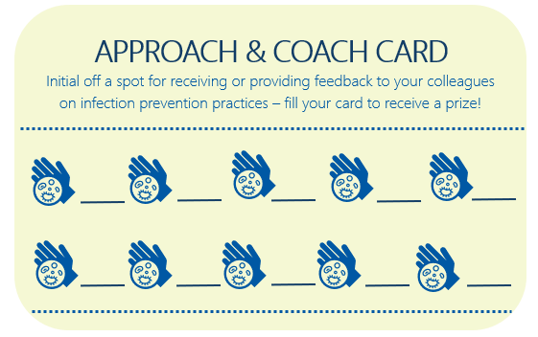
Other examples to promote positive hand hygiene culture:
Incentivize giving and receiving hand hygiene feedback
  Use a “Approach and Coach Card” for feedback
  Fill up card and earn a prize, trophy, parking spot – whatever makes staff feel recognized
  Compete among units/floor/departments
Notes:
Another way your facility may consider to promote a positive hand hygiene culture is by incentivizing giving and receiving hand hygiene (or other infection prevention practices) feedback.
An example of this could be through a “Approach and Coach Card” system. When feedback is given, the feedback receiver and the feedback initial off a spot on their card. After a unit, floor, or department collectively has a certain number of punches; celebrate with pizza party, ice cream party, gift cards, prize, trophy, award, or parking spot. Your facility can choose whatever makes most sense for your staff. Staff who attend the training could receive an initial!

Slide 26

Promoting a positive hand hygiene culture: The secret to giving great feedback
Notes:
Providing regular feedback promotes a positive hand hygiene culture. It is important to celebrate our peer's good practices and to keep each other accountable when we notice less than best hand hygiene practices. However, giving feedback can be difficult and many of us are not comfortable doing it. Let’s take a look at this video that describes how to give great feedback.
The secret to giving great feedback | The Way We Work, a TED series - YouTube

Slide 27
Practice giving and receiving feedback:
How could I supportively approach and provide feedback to a colleague that I notice not adhering to best hand hygiene practices?
How could I provide positive feedback to a colleague that is performing best hand hygiene practices?
1. The micro-yes
2. Data point
3. Impact
4. Question
Notes:
Now that you have learned the secret to providing great feedback, let’s practice giving and receiving feedback. With a partner, practice how you could provide feedback to a co-worker not adhering to best hand hygiene practices and practice providing feedback to a co-worker that is performing best hand hygiene practices.
*Pause the recording for 5 minutes to complete this activity, then return to the recording*
Examples:
“I have some ideas on how we can improve some of our infection prevention practices. Do you have a couple minutes to talk about it? I noticed that after you took Mrs. Johnson’s vitals, you didn’t perform hand hygiene. The important moments of hand hygiene indicate we should perform hand hygiene before and after touching a resident and after touching medical equipment. I know many facilities in our area are struggling with the transmission of MDROs and hand hygiene is one of the most effective ways in preventing transmission of infection. What are your thoughts about it?”
“I noticed that you have really good hand hygiene practices. Do you have a second to chat about it? I saw you perform hand hygiene as you exited each resident room when you were doing rounds. Each time I saw you not just rub your hands but interlock your fingers, rub around your thumbs and wrists and underneath your fingernails. Thank you for doing your part to break the chain of infection! Maybe at our next team meeting you could discuss some strategies that help you with your hand hygiene practices?”

Slide 28
Summary
Hand hygiene is everyone’s job in the long-term care setting
Hand hygiene prevents the spread of germs
Remember the important moments for hand hygiene
Healthcare workers have the power to create a positive hand hygiene culture
Notes:
In summary, hand hygiene is a part of everyone’s job in the long-term care setting. It is one of the most effective ways we can prevent the spread of germs and keep residents, staff, and visitors safe. We must remember the important moments for hand hygiene and use it in our day-to-day work. And finally, as healthcare workers, you have the power to build and maintain a positive hand hygiene culture.

Slide 29

Please take as little as 5 minutes to provide feedback on this training!
Upon completion of the survey, you will receive a proof of attendance certificate.
We read every response and do our best to incorporate your feedback into future resources.
Thank you!
https://hennepinco.az1.qualtrics.com/jfe/form/SV_b26WOMtu2KNhV0G
LTC.InfectionPrevention@hennepin.us
Notes:
On behalf of the Long-term Care Infection Prevention Coalition of Hennepin County, thank you for attending this training. We encourage you to take this extremely short survey to tell us how we did and to provide suggestions on how we can improve. You can access the survey using the QR code pictured or the link on the screen. Upon completion of the survey, you will receive a proof of attendance certificate. We read every response and do our best to incorporate your feedback into future resources.
If you’d like to join this coalition or have questions, please email LTC.InfectionPrevention@hennepin.us

Slide 30
Resources
CDC, Olmsted, R., Gilmartin, H. M., & Washer, L. (n.d.). Core Concepts for Hand Hygiene: Clean Hands for Healthcare Personnel [Slide show].
CDC Supported Projects: Regional Approaches to Combating the Spread of Multi-drug Resistant Organisms. (2017, February 28). cdc.gov. Retrieved November 29, 2023.
Your Five Moments for Hand Hygiene. (2009, May). World Health Organization. Retrieved November 29, 2023.
Project Firstline Hand Hygiene Steps. (2023, May). Minnesota Department of Health. Retrieved November 29, 2023

