Slide 2

Ryan White Subrecipient Monitoring

Slide 3
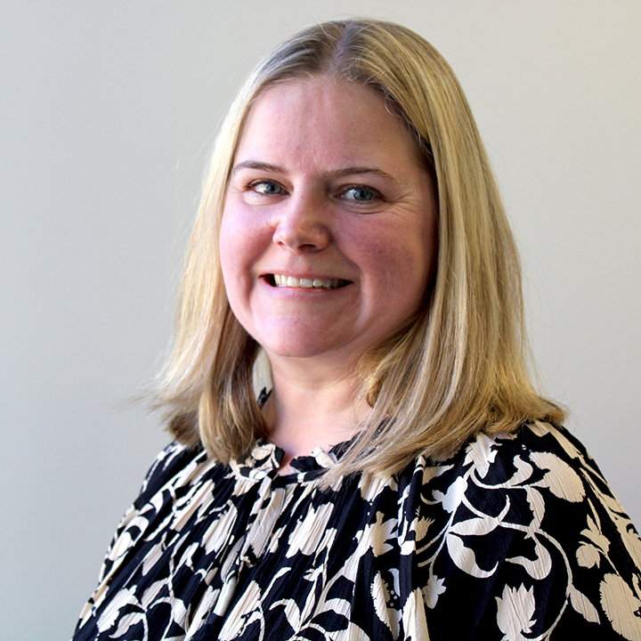



Hennepin County Ryan White Subrecipient Monitoring Team
Carissa Weisdorf
Lead HIV Services Planner
Carissa.Weisdorf@Hennepin.us
Scott Bilodeau
Quality Management Coordinator
Scott.Bilodeau@Hennepin.us
Eriika Etshokin
Ryan White Grants Supervisor
Eriika.Etshokin@Hennepin.us
Aurin Roy
Senior Planning Analyst
Aurin.Roy@Hennepin.us

Slide 4
Subrecipient Monitoring
Monitoring is a critical aspect of the implementation of the Ryan White HIV/AIDS Program (RWHAP).
Like all RWHAP funding recipients, Hennepin County is responsible for adequate oversight and monitoring of all activities supported by the federal award, including subawards and contracts.
Hennepin County monitors subrecipient conduct through annual site visits, quarterly reporting, invoice/expenditure and client-level data (CAREWare) reviews.
Subrecipient Monitoring is an opportunity to learn together, share best practices, troubleshoot new strategies, and identify opportunities for collaboration, training, and technical assistance as needed.
Hennepin County Ryan White Program
Subrecipient onboarding – Subrecipient Monitoring

Slide 5
Site Visits
Site visits are done annually and include fiscal/programmatic interviews with site staff, and chart reviews to ensure adherence to service standards, universal standards, and program eligibility requirements.
In early Spring, all providers will receive communication from Hennepin County staff with guidance and scheduling to set up the site visit. Each site visit will include a review of client charts from the previous year.
The number of clients to be reviewed at each site is determined based upon the number of Ryan White clients served at that site:
1-50 Clients: 100% of charts reviewed | 501 – 1000 Clients: 10% of charts reviewed (maximum of 75)
51-100 Clients: 50% of charts reviewed | 1000+ Clients: 5% of charts reviewed (maximum of 75)
101 – 500 Clients: 20% of charts reviewed (maximum of 75) | 25% of charts pulled are reviewed for compliance with Universal Standards
Hennepin County Ryan White Program
Subrecipient onboarding – Subrecipient Monitoring

Slide 6
Quarterly Reports
Overview
Due Dates
Quarterly Reports are required from each provider for each Hennepin County managed Ryan White contract. The report is meant to provide a progress update on service performance, QI goals, provide updates on any programmatic changes, and identify technical assistance needs
A week before they are due, all providers will receive an email reminder with a link to the Qualtrics report.
Only one person from each organization is to submit the report – it must be completed and submitted on the same computer.
Resources for submission are available on the Ryan White HIV Services- Hennepin County webpage.
The quarterly reports will include a prompt for providers to select a time for a follow-up quarterly meeting.
Part A (Fiscal Year 3/1 - 2/28) | Part B/Rebate (Fiscal Year 4/1 - 3/31)
Quarter 1: June 20 | Quarter 1: July 20
Quarter 2: September 20 | Quarter 2: October 20
Quarter 3: December 20 | Quarter 3: January 20
Quarter 4: March 20 | Quarter 4: April 20

Slide 7

Quarterly Calls
Quarterly Calls are an opportunity for Hennepin County staff to learn more about "on the ground" service provision and offers providers a recurring check-in point to ask questions, give feedback, and report program changes.
When completing the Quarterly Report in Qualtrics, providers will be prompted to select a time in the next two weeks to conduct a Quarterly Call with Hennepin County's Ryan White staff.
Provider staff is responsible to ensure appropriate staff who can speak to the agenda items listed below participate in these calls.
Agenda items will include the following:
Review of CAREWare data | Staffing Changes
Review of spending to date | Grievances/Wait List
CQM/QI Plan Progress | Technical Assistance (TA) and Training Needs
Site Visit Findings Discussion

