Slide 1
Ryan White Program

Slide 2

Service standards overview
Hennepin County Ryan White Program
Subrecipient onboarding – Service standards overview

Slide 3
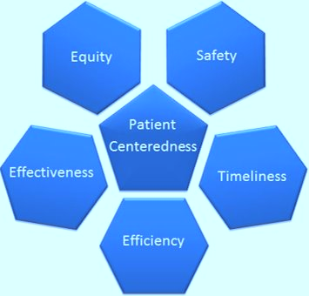
Purpose of service standards
Quality care
Improve health outcomes
Compliance
Ensure funded services are consistent with
  Public health guidelines on HIV treatment
  Client needs
  Guidelines for improvement in access and quality of HIV services
Hennepin County Ryan White Program
Subrecipient onboarding – Service standards overview

Slide 4

Goals of service standards
Encourage continuous improvement
Protect client rights and privacy
Ensure accessibility to services
Ensure services are culturally appropriate
Means for client feedback or complaint
Ensure transparency
Reduce barriers to care

Slide 5
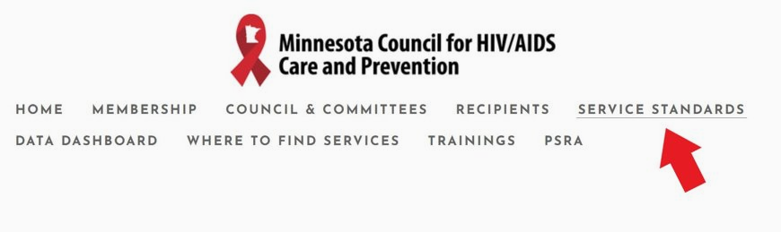

MN HIV Council website
www.mnhivcouncil.org

Slide 6
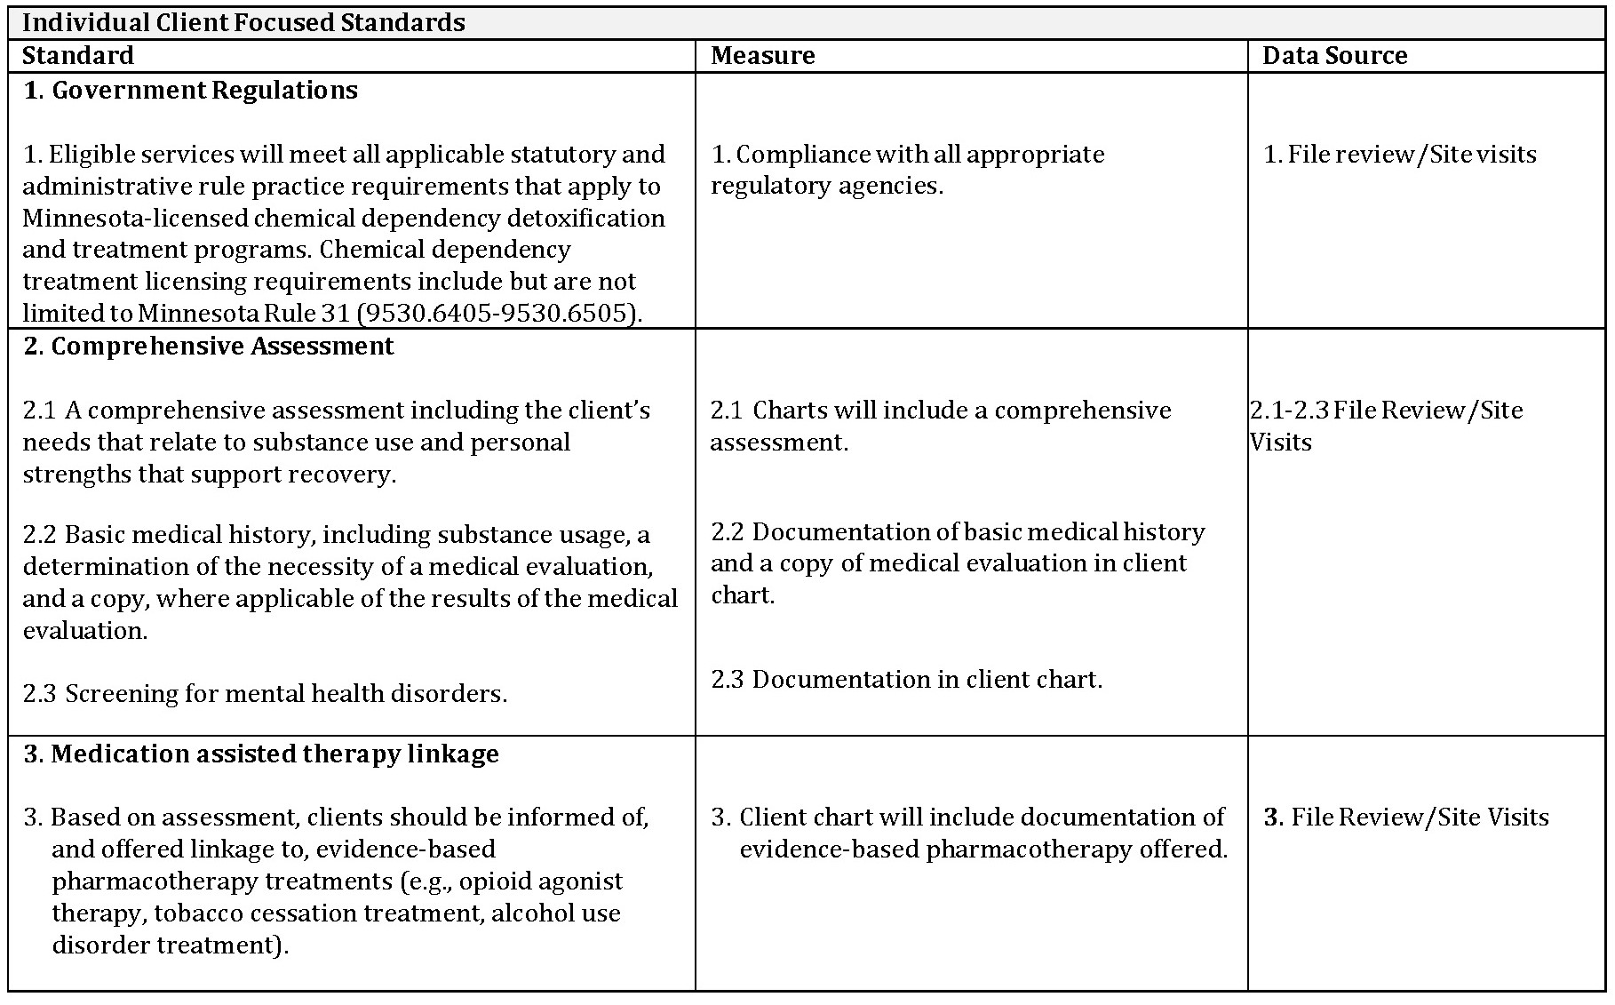
Example: Substance Abuse Outpatient
Service Standard

Slide 7
Early Intervention Services
Emergency Financial Assistance
Food Bank/Home-delivered Meals
Health Education/Risk Reduction
Health Insurance Premium and Cost Sharing
Home and Community-based Health Services
Housing Services
Legal Services
Medical Case Management
Medical Nutrition Therapy
Medical Transportation
Mental Health Services
Non-medical Case Management
Outpatient/Ambulatory Health Services
Outreach Services
Psychosocial Support Services
Referral for Health Care and Supportive Services
Substance Abuse Outpatient Care
Treatment Adherence
Service-specific standards

Slide 8
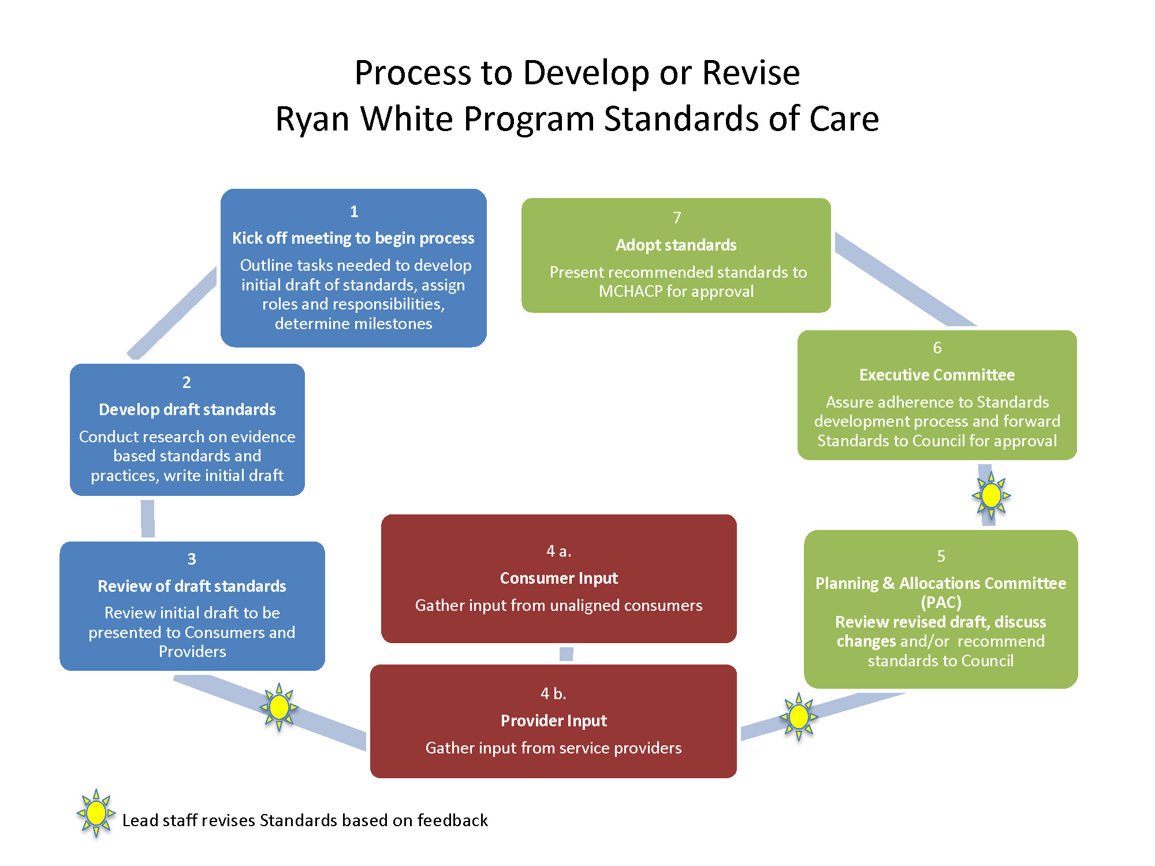
Developing and updating service standards
Hennepin County Ryan White Program
Subrecipient onboarding - Service standards overview

Slide 9
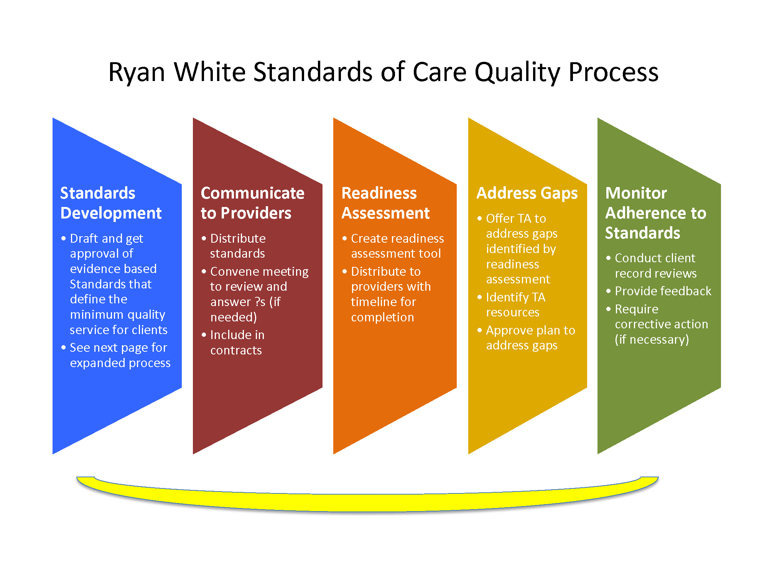
Service standards in action
Hennepin County Ryan White Program
Subrecipient onboarding - Service standards overview

Slide 10
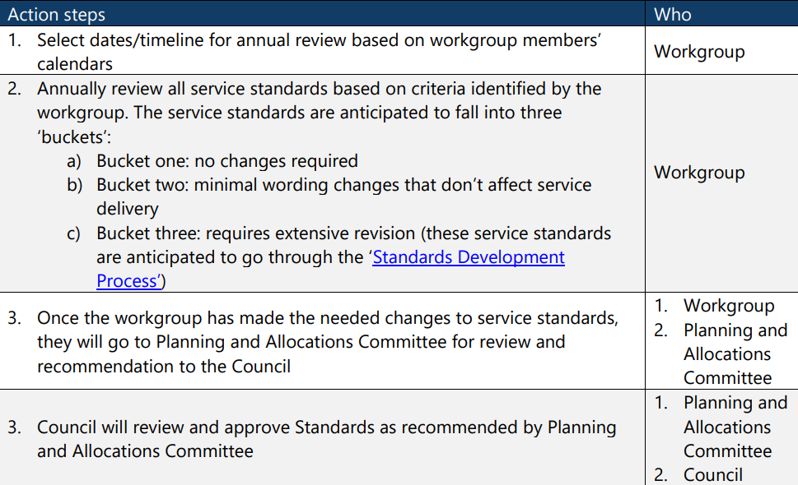
Service standards annual review process
Hennepin County Ryan White Program
Subrecipient onboarding - Service standards overview

Slide 11

Universal Standards
Client Rights
Eligibility
Subrecipient Qualifications
Administration
Linkage & Retention
Quality Management
Cultural Responsiveness

Slide 12

Client Rights
Access to services
No discrimination
Inform client of policies and rights
Confidentiality and HIPAA
Get consent
Release of Information (ROI)

Slide 13
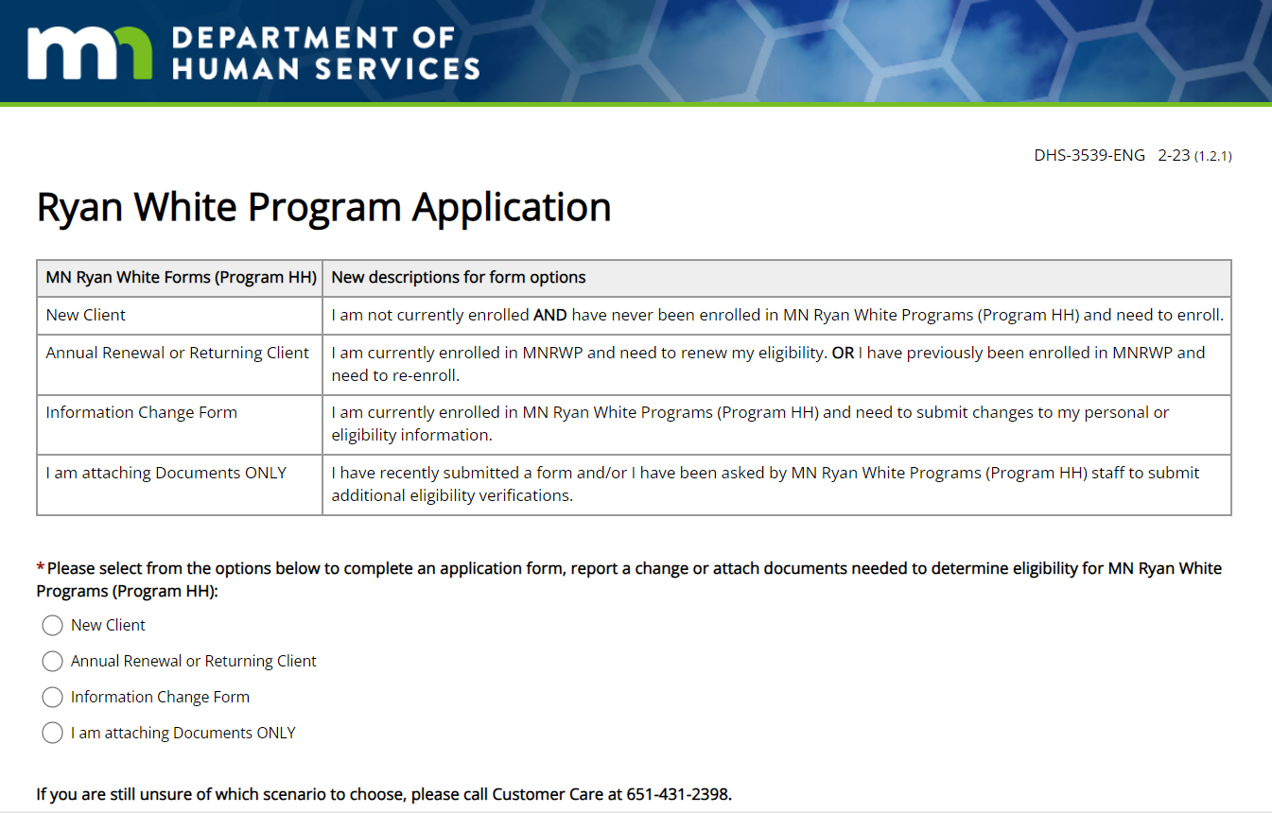
Eligibility
MN DHS determines eligibility
Providers support clients by
  Completing new applications and annual renewals
  Submitting changes in income, household size, residency, or health insurance status to Ryan White eligibility specialists
Complete the Ryan White Program Application online for new clients, renewal, information change, and to attach documents
A fillable form to print and return by mail is also available
Hennepin County Ryan White Program​
Subrecipient onboarding - Service standards overview

Slide 14
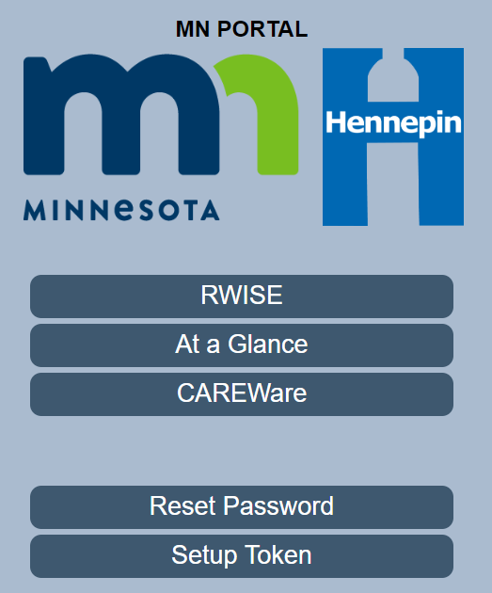
Eligibility
Have a documented policy to:
  Verify client’s Ryan White eligibility via the “At a Glance” screen
  Screen for duplication of services
  Ensure Ryan White is payer of last resort
This is prior to initiating services and periodically as services continue
Support clients in completing new applications and annual renewals, and submitting changes in income, household size, residency, or health insurance status to Ryan White eligibility specialists
Hennepin County Ryan White Program​
Subrecipient onboarding - Service standards overview

Slide 15


Record Keeping
Separate file for each client
Files are in a secure place
Electronic/computer files must be password protected & backed up

Slide 16

Personnel
HIV/AIDS knowledgeable
Necessary skills and competence
Ryan White orientation
Continued learning and professional development
Necessary licensure and certificates
Supervision

Slide 17
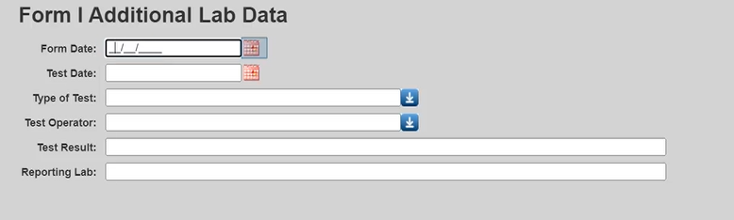
Client viral load data
CAREWare Form 1 is used when viral load data is missing. The CAREWare admin team will reach out to providers who need to complete it for clients.
Has the client had a lab value in the last 12 months?
If yes – Confirm lab value is in CAREWare
If no – If lab value is within the last two months, no data is needed. If lab value is more than two months old, input data into Form 1.
If no lab value in the last 12 months refer to HIV medical care and confirm linkage. Follow-up with client or medical office.

Slide 18

Quality Management
Quality improvement to ensure health outcomes for Ryan White clients are continuously improving
Seek client input on programming

Slide 19
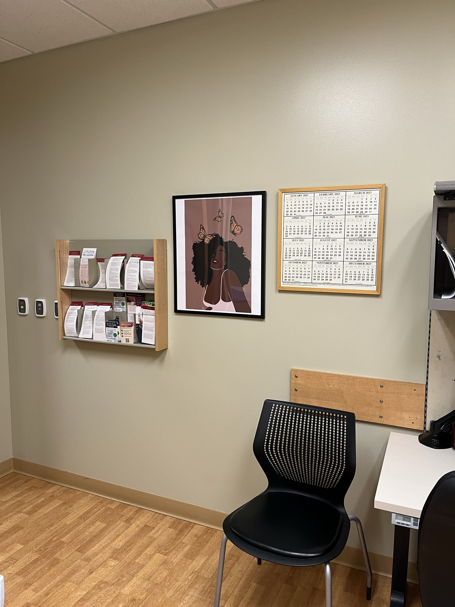
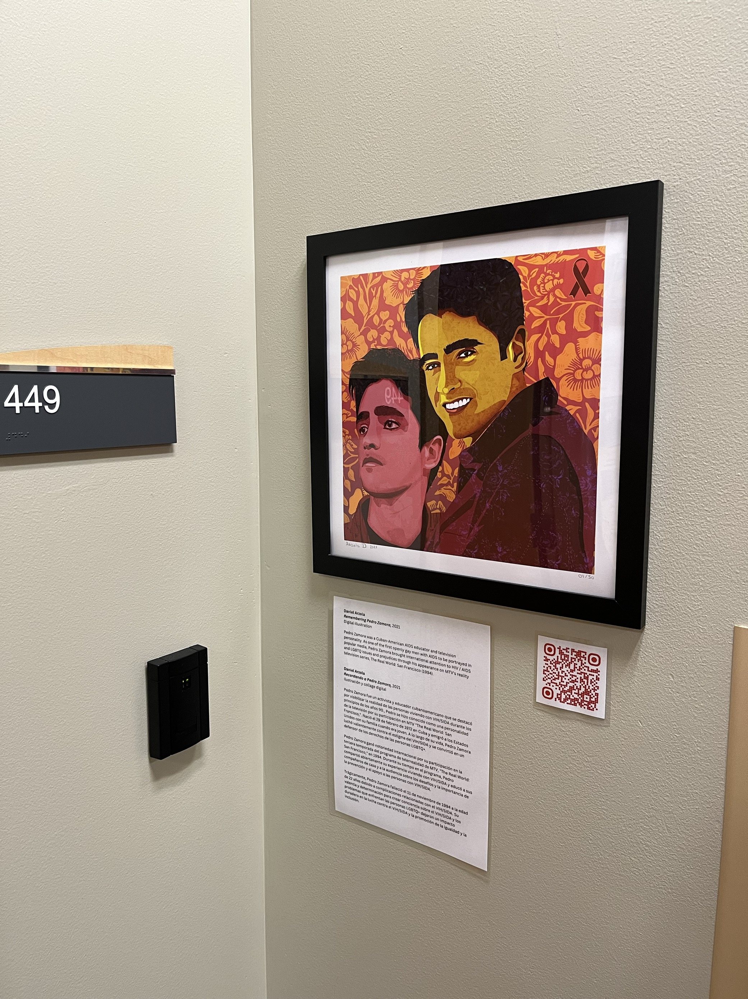
Cultural Responsiveness
Provide a welcoming environment that is culturally inclusive and respectful of the client populations being served

Slide 20

Cultural Responsiveness
Collect and analyze client demographic data to identify disparities and develop strategies to eliminate disparities, as well as to support continuous improvement around cultural responsiveness.

Slide 21

Cultural Responsiveness
Staff qualifications
Staff training
Trainings on culturally responsive practices done at your organization
Trainings arranged by Hennepin County and DHS
  Engaging African-born Communities in Sexual Health Education and Communication
  Provider Connections meetings
Encourage the employment of program staff who are able to serve the client population in a culturally responsive way.

Slide 22
Translation and interpretation services
No-charge for Ryan White clients who need it
Policy and procedure at https://bit.ly/RWlanguage
  Telephone interpretation
  In-person interpretation
  American Sign Language (ASL) interpretation
  Materials translation

Slide 23
Annual site visits
Measure compliance with fiscal and programming requirements
Financial review
Client file review
  Reviewed for compliance with Universal Standards and service-specific standards
  Number of charts is based on a formula – maximum of 75
  Assessment checklist is provided in advance
Interview between contract manager, Hennepin County Ryan White team, and key staff
Corrective Action Plan may be required for any site visit findings

Slide 24

Performance measures = Expected outcomes
Outlined in contracts
Includes effectiveness and efficiency measures
Reported in quarterly reports and annual site visits

Slide 25
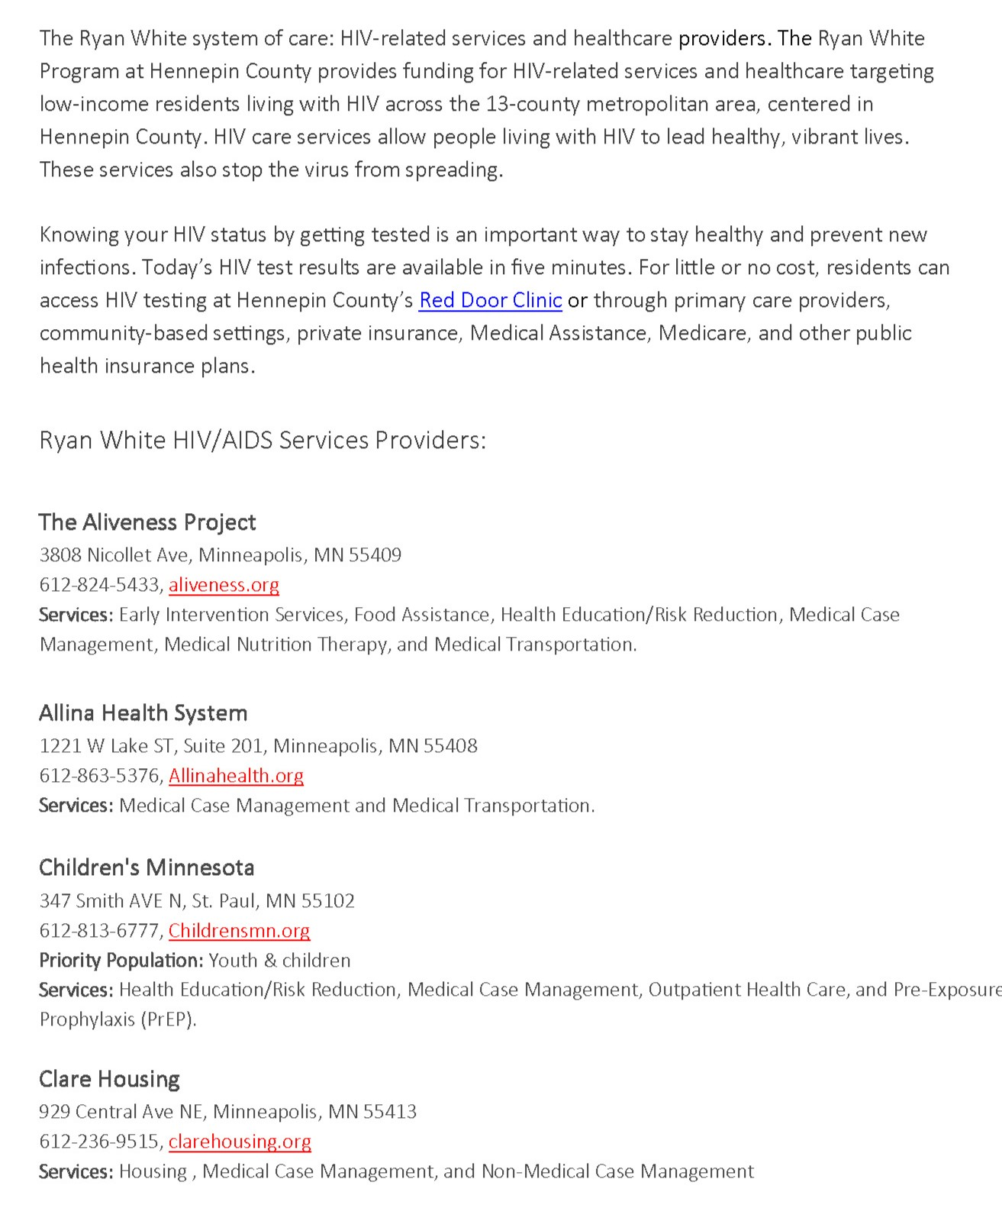
Ryan White system of care fact sheet
Updated by Hennepin County Ryan White Program
Available at:
  https://www.hennepin.us/ryan-white#get-help
  https://www.mnhivcouncil.org/where-to-find-services.html
Hennepin County Ryan White Program
Subrecipient onboarding - Service standards overview

