Slide 2

Ryan White Quality Management (QM)
Hennepin County Ryan White Program
Subrecipient onboarding – Quality Management

Slide 3


Hennepin County Ryan White QM Team
Scott Bilodeau
Quality Management Coordinator
Scott.Bilodeau@Hennepin.us
Aurin Roy
Senior Planning Analyst
Aurin.Roy@Hennepin.us
Hennepin County Ryan White Program
Subrecipient onboarding – Quality Management

Slide 4
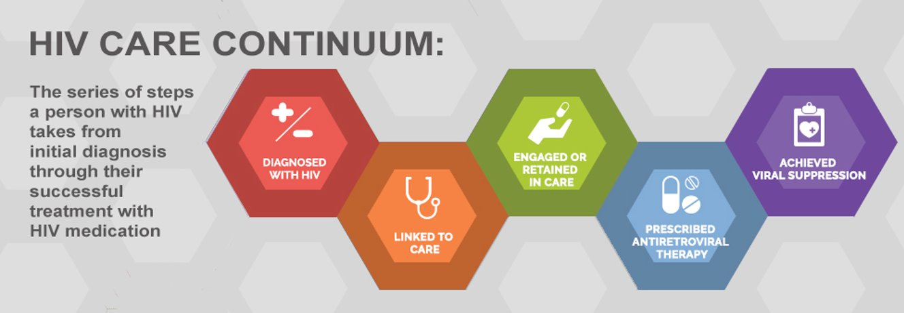
Quality Management Goals
Increasing Viral Suppression ● Reducing Infections ● Proving Impact ● Illuminating What Works
Source: https://www.hiv.gov/federal-response/policies-issues/hiv-aids-care-continuum/
Hennepin County Ryan White Program
Subrecipient onboarding – Quality Management

Slide 5
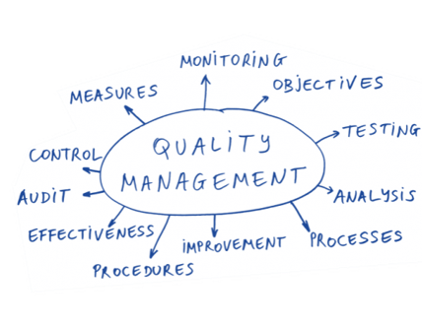
What is Quality?
The degree to which a health or social service meets or exceeds established professional standards and user expectations (source: HRSA HAB & IoM)
Examples include:
  Addressing epi and health outcome disparities through service enhancements
  Evaluating accuracy and efficacy of data collection procedures
  Fixing system glitches that affect referrals, client services flow, retention, or client satisfaction
  What is Quality Management?
  All activities and tasks needed to maintain a desired level of excellence, such as:
  Development of Standards of Care
  Creation of quality policy
  Creating & implementing quality plans
  Quality control
  Quality improvement
Hennepin County Ryan White Program
Subrecipient onboarding – Quality Management

Slide 6

Purpose of Ryan White Quality Management
Improve health outcomes
Show your impact
Stay compliant
Learn & improve
Ensure funded services are consistent with:
  Public Health Guidelines on HIV treatment
  Client needs
  Guidelines for improvement in the access to, and quality
  of HIV services
  Meeting standards of care
  Addressing emerging or unearthed disparities
  HRSA Grant Requirements
Hennepin County Ryan White Program
Subrecipient onboarding – Quality Management

Slide 7
RW Quality Management Team Oversight
Early Identification of Individuals living with HIV/AIDS (EIIHA) Goals and Workgroup
Clinical Quality Management (CQM) Goals
Quality Management Advisory Committee (QMAC)
Quality Learning Community (QLC) & Basecamp
Quality Improvement (QI) Plan Advisement and Guidance for subrecipients
Client/Consumer Quality Engagement
Other Projects – create+equity / RW Enrollment / Focus Groups
Hennepin County Ryan White Program
Subrecipient onboarding – Quality Management

Slide 8
Quarterly Reports
Providers submit a report on their Part A and Part B/Rebate funded programming as follows:
Part A (Fiscal Year 3/1 – 2/28)
  Quarter 1: June 20
  Quarter 2: September 20
  Quarter 3: December 20
  Quarter 4: March 20
Part B (Fiscal Year 4/1 – 3/31)
  Quarter 1: July 20
  Quarter 2: October 20
  Quarter 3: January 20
  Quarter 4: April 20
Hennepin County Ryan White Program
Subrecipient onboarding – Quality Management

Slide 9
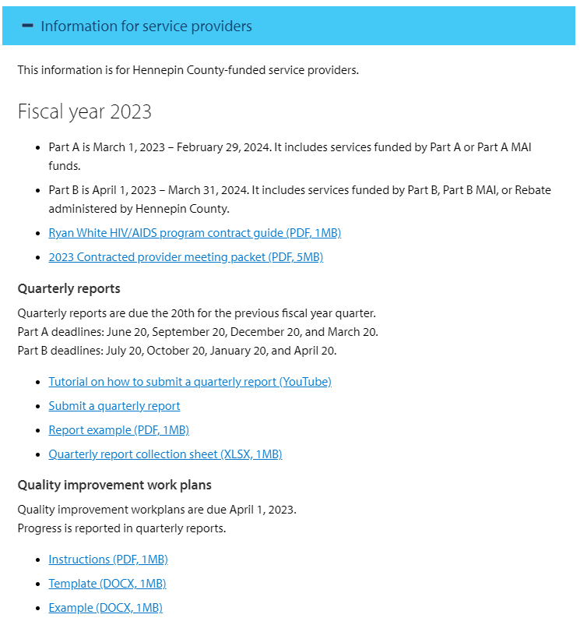
Quarterly Reports
HC RWHAP sends all RW-funded providers an email a week before reports are due. Extension may be requested at that time if needed.
Providers report progress on service performance and QI plans via Qualtrics.
Only one person from each organization can submit the report and it must be completed and submitted on the same computer.
Resources for submission may be found on the Ryan White HIV Services – Hennepin County webpage.
HC RWHAP staff review the data and provide constructive feedback or requests for clarification. Narratives and requests for technical assistance/training are encouraged!
An all-provider training will be conducted by the QMC team in February to review and advise on the report.
A sample report can be found here: Report Example
Hennepin County Ryan White Program
Subrecipient onboarding – Quality Management

Slide 10
Annual Site Visits
HC RWHAP staff meets with all Part A funded providers every spring to assess performance and ensure programmatic compliance with universal standards, service standards, and eligibility requirements.
HC RHWAP Grants Management, HIV Services Planning, and Quality Management staff will review client charts.
Contract Managers will meet with key staff to review finance, staffing, contract compliance, and program updates.
Any findings that do not meet standards are discussed during the site visit – providers may have a deadline to provide documentation that was not available during the site visit.
Some findings may require the submission of a Corrective Action Plan within 60 days. The purpose is not to be punitive but to ensure that clients receive a comparably high level of service at any provider in the Ryan White system of care.
Hennepin County Ryan White Program
Subrecipient onboarding – Quality Management

Slide 11

Quality Improvement (QI) Plans
Every year, sub-recipient providers are required to create and maintain at least two QI Goals.
This is a fun and interesting opportunity to experiment and try out some new approaches to improve services and learn together in the process!
QM staff will provide training in February to review Quality concepts and provide guidance on planning, crafting, and implementing QI Plans.
We will first look at addressing any findings from the yearly site visit, and then review system-wide QM goals adopted by the Quality Management Advisory Committee.
The QM team will also meet individually with providers to provide further guidance and constructive feedback before plans are due on April 1st and throughout the quarterly reporting process.
We are here to support you in reaching your QI Goals!
Hennepin County Ryan White Program
Subrecipient onboarding – Quality Management

Slide 12
QM Expectations of Subrecipients
Plan, Craft, and Implement required annual QI Projects.
Report quarterly on performance measures and QI Projects.
Obtain consumer input and take appropriate actions.
Continuously improve health outcomes for consumers.
Meet universal and service-specific standards.
Submit required data in a timeline manner.
Hennepin County Ryan White Program
Subrecipient onboarding – Quality Management

Slide 13
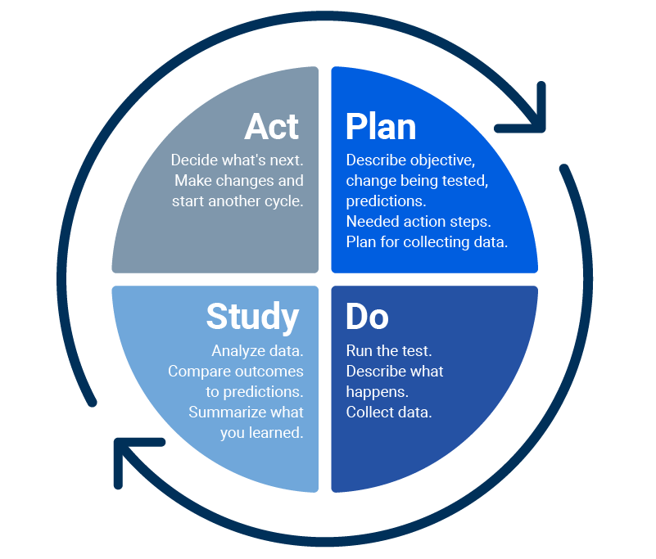
HC RWHAP Quality Improvement Approach
First ask this:
Then do this:
What are we trying to accomplish?
How will we know that a change is an improvement?
What can we do that will result in improvement?
Hennepin County Ryan White Program
Subrecipient onboarding – Quality Management

Slide 14
Sample Fiscal Year 2024 Quality Improvement Plan Form
1. Agency name:
2. Name and contact information for the person(s) submitting this plan:
3. This is a plan for: ☐ Part A ☐ Part B/Rebate
4. Services funded for the above part(s):
Do you and your staff have sufficient quality management capacity to carry our quality improvement projects using the Plan-Do-Study-Act (PDSA) cycle? ☐ Yes ☐ No
If no, would you like in-service training for your staff on quality improvement projects and PDSA cycles? ☐ Yes ☐ No
Measurable QI Goal #1 (of at least 2)
  QI goal/aim statement: “Improve the viral suppression rate among a cohort of clients that were unstably housed as of 12/31/23 to 75%.” (Example)
  Intervention/strategy that will help you achieve your goal:
  Staff responsible for intervention:
  How will you measure progress?
    Process measures:
    Outcome measures:
  Where will you track the data?
  How will your progress be communicated and to whom?
Hennepin County Ryan White Program
Subrecipient onboarding – Quality Management

Slide 15
Guiding Principles for Subrecipient QI Plans
QI Plan/Project(s) addresses clients and/or services for all our funding sources
QI Goal(s) is specific
QI Goal(s) is measurable
QI Goal(s) is attainable
QI Goal(s) is relevant
QI Goal(s) is time-bound
QI Goal(s) is inclusive
QI Goal(s) is equitable
QI Goal(s) is an improvement on what we accomplished year to date or last year
Staff involved in these programs have agreed to these projects and reviewed this submission
Program leadership has reviewed and agreed to this submission
QI Project/Intervention is specific, and it is clear what we are going to do to reach our goal
QI Project/Intervention is not the same project/intervention we wrote last year
Hennepin County Ryan White Program
Subrecipient onboarding – Quality Management

Slide 16

Keep in Mind
Plans should have some level of involvement, advisement, and/or feedback from:
  Leadership
  Front-line staff
  Clients
What resources do you need to accomplish your goal?
How will you stay on track?
How will you report progress?
How will you adjust if things aren’t working as planned?
Hennepin County Ryan White Program
Subrecipient onboarding – Quality Management

Slide 17
FY 2023 Provider QI Projects Overview
15 Ryan White providers​ conducted 35 Quality Improvement Projects, focused on the following:
20 on disparity reduction | 2 on diagnosing more people with HIV
9 on viral suppression | 2 on cultural responsiveness
4 on housing | 2 on engagement/retention in care
4 on consumer engagement | 1 on data completeness
3 on enrollment | 1 on harm reduction
2 on building infrastructure
Hennepin County Ryan White Program
Subrecipient onboarding – Quality Management

Slide 18

Criteria for Success: How will you be evaluated?
Performance for outcomes in contract
Quality Improvement Plan addressing (annually):
  Improved Performance aligned with HRSA/HAB measures and client needs
  Care Continuum
  Data Quality
  Quality Capacity
  Disparities
Track your progress regularly
Report quarterly
Continuously improve
Comply with standards of care
Have successful site visits
Hennepin County Ryan White Program
Subrecipient onboarding – Quality Management

Slide 19
Quality Management Advisory Committee (QMAC)
QMAC meets quarterly on the third Thursday of February, May, August, and November and is comprised of:
  Minnesota funders
  One representative from all Part A TGA subrecipient providers
  Consumers/clients of publicly funded HIV services
  Guests are welcome
QMAC provides advice on system-wide CQM initiatives across publicly funded HIV services by:
  Reviewing the annual funder quality management plan
  Establishing systemwide CQM goals and measures based on data
  Collaborating, learning from, and sharing with other providers and consumers
  Learning, practicing, and implementing quality concepts
The system-wide CQM goals that QMAC approves in February are important as they serve to guide subrecipient providers when they are formulating their yearly QI plans, which are due on April 1st (no joke!)
Hennepin County Ryan White Program
Subrecipient onboarding – Quality Management

Slide 20
Systemwide CQM Goals for 2023 (Example)
No. | Goal | Baseline (CY2022)
1 | 90% of RWP TGA Black/African American MSM consumers are virally suppressed | 87.7% (10.4% missing VL) Range: 57.1% - 95.2%
2 | 33% of all individuals tested for HIV in the TGA are men of color who have sex with men | 1.6% (30/1845) (FY2022) Range: 0% - 3.3%
3 | 4,445 people with HIV are enrolled in the RWP in the TGA (about 55% of all people living with HIV in the TGA based on 2021 data) | 3,883 (preliminary)
4 | 58% of a cohort of RWP TGA who were unstably housed and not virally suppressed as of 12/31/22 are virally suppressed | 53.6% (15/28) of 2021 cohort as of 12/31/22
5 | Increase the percentage of HIV outbreak cases who are virally suppressed to 75% | 68.6% (131/191) (16% missing VL)
Hennepin County Ryan White Program
Subrecipient onboarding – Quality Management

Slide 21
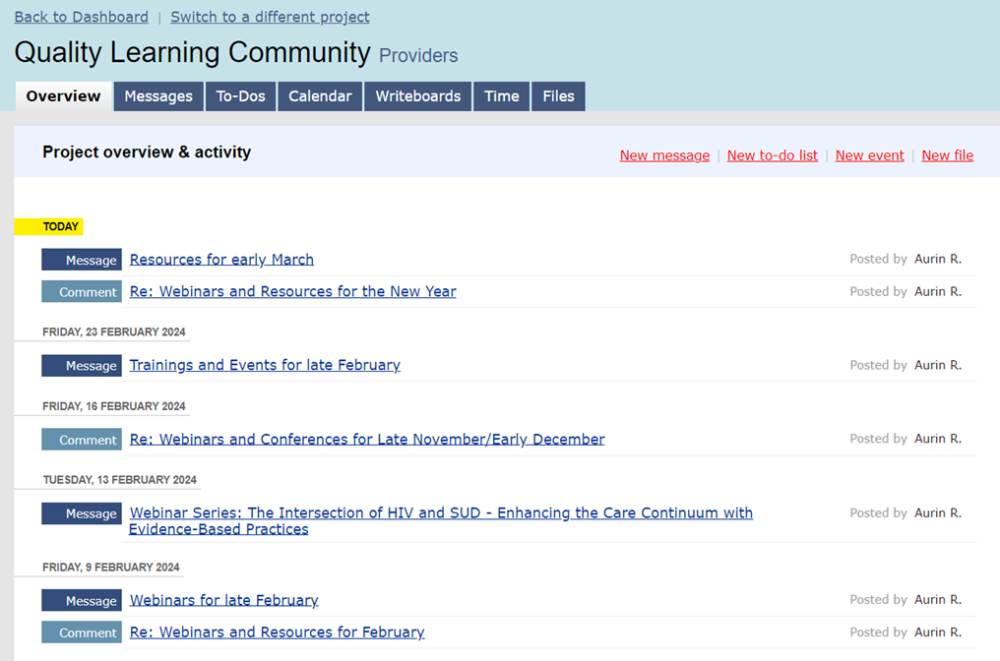
Quality Learning Community (QLC)
Periodically throughout each month, information about relevant webinars, trainings, local events, and links to information that can help supplement your work and quality efforts will be posted on the interactive Basecamp web page.
Providers, community members, and consumers are all welcome to join. Send an email to Scott.Bilodeau@hennepin.us to be included in email notifications.
Hennepin County Ryan White Program
Subrecipient onboarding – Quality Management

Slide 22
EIIHA Overview
Early Intervention of Individuals with HIV/AIDS (EIIHA) is the identifying, counseling, testing, informing, and referring of undiagnosed and diagnosed individuals to appropriate services, as well as linking newly diagnosed HIV positive individuals to medical care.
The goals are to increase:
  the number of individuals aware of their status (testing);
  the number of HIV positive individuals who are in medical care (linkage); and
  the number of HIV negative individuals referred to services that contribute to keeping them HIV negative (referrals) – sometimes referred to as a Status Neutral Approach.
Hennepin County Ryan White Program
Subrecipient onboarding – Quality Management

Slide 23
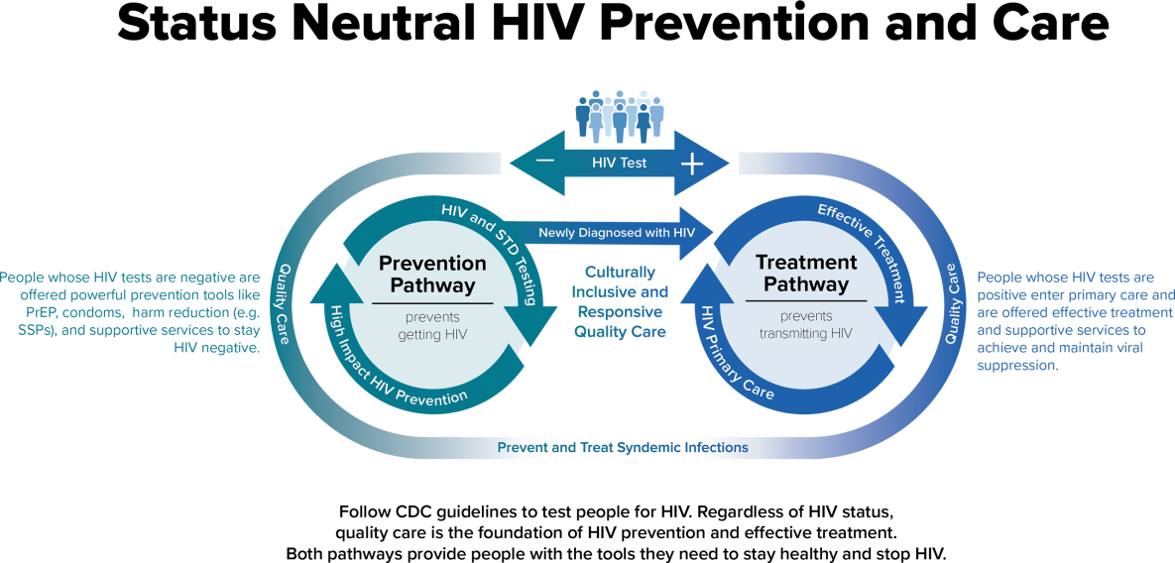
Source: https://www.cdc.gov/hiv/effective-interventions/prevent/status-neutral-hiv-prevention-and-care/index.html
Hennepin County Ryan White Program
Subrecipient onboarding – Quality Management

Slide 24
EIIHA Background
3-Year EIIHA Cycle
Year 2: Assess & Report on Plan Progress
Year 3: Assess & Report on Plan Progress
Year 1: Develop Plan and Goals
Per the 2009 Ryan White Act reauthorization, Planning Council is required to assess needs of those unaware of their status.
EIIHA plans and efforts impact Part A Supplemental funding.
The Council and grant recipients and subrecipients work towards reducing the proportion of PWH who are unaware of their status.
HRSA requires Parts A and B recipient funders to have EIIHA plans in their grant applications – this accounts for 33% of Part A’s application score.
“Diagnose” is the first pillar of Minnesota’s and the Part A 13-county grant area’s Integrated HIV Prevention and Care Plan
Hennepin County Ryan White Program
Subrecipient onboarding – Quality Management

Slide 25
Minnesota EIIHA Workgroup
Consists largely of providers (Ryan White and MDH-funded) involved with EIS-related outreach testing and care linkage services.
Integrates the work of Hennepin County's and DHS's quality advisory boards.
Reviews epidemiological data and makes recommendations to recipients and to the Council.
Meets annually, usually in the first half of the year.
Creates, monitors, and evaluates progress towards EIIHA goals over three year cycles.
Meetings are announced at QMAC, Basecamp, and through other community distribution lists. Contact Quality Management staff if interested in attending.
Hennepin County Ryan White Program
Subrecipient onboarding – Quality Management

Slide 26

EIIHA Related Services
Early Intervention Services
Counseling and HIV Testing
Syringe Services
HIV Education & Outreach
Partner Services
PrEP
Hennepin County Ryan White Program
Subrecipient onboarding – Quality Management

