Slide 2

Contracts & Invoices
Hennepin County Ryan White Program
Subrecipient onboarding – Contracts & Invoices

Slide 3
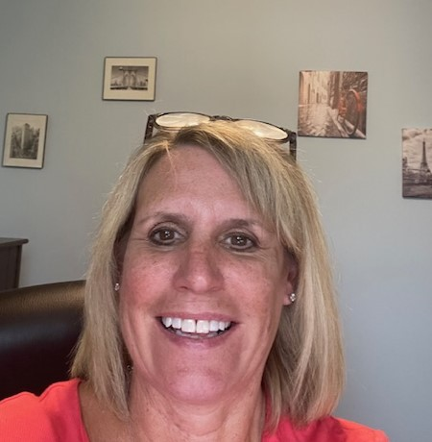

Hennepin County Ryan White Contract Managers
Jacki Gould
Jacki.Gould@Hennepin.us
Aliveness Project, Healthcare for the Homeless, HealthPartners, Hennepin Healthcare, MN Community Care, Red Door Clinic, West African HIV Task Force
Walter Urey
Walter.Urey@Hennepin.us
Allina, Children's, Clare Housing, Open Arms, Pinnacle, Rainbow Health, Sub-Saharan African Youth and Family Services of MN
Hennepin County Ryan White Program
Subrecipient onboarding – Contracts & Invoices

Slide 4
Ryan White HIV/AIDS Program Parts A & B
Hennepin County administers Ryan White Contracts for Parts A and B. Some providers also receive Ryan White funding directly from HRSA (Parts C or D) and/or from other local government agencies. This presentation is specific to Ryan White Contracts administered by Hennepin County.
Your contract with Hennepin County will note in the first line, "This agreement is between the COUNTY OF HENNEPIN, STATE OF MINNESOTA....".
For guidance related to Ryan White funding from HRSA or another government agency, please reach out directly to those administrators.

Slide 5
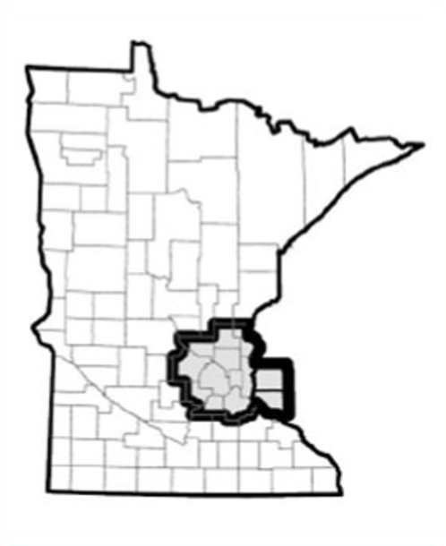
Funding Sources and How to Use Them
Any services charged to the Ryan White Part A Grant must be for clients living within the Transitional Grant Area (TGA), which includes the following counties:
Part A | Clients must live in the TGA as outlined to the left. For providers receiving both Part A and Part B/Rebate funds, Part A funds are to be expended first.
Part A MAI | Clients must live in the TGA as outlined to the left. Clients must identify as Hispanic/Latino, Black (African-born and African American), and/or American Indian/Alaska Native. For providers receiving both Part A and Part A MAI funds in the same service category, efforts should be made to fully spend MAI funds first.
Part B | Clients must live in the state of Minnesota Funds must reach prioritized populations
Rebate | Clients must live in the state of Minnesota Funds must reach prioritized populations
Anoka (MN) | Scott (MN)
Carver (MN) | Sherburne (MN)
Chisago (MN) | Washington (MN)
Dakota (MN) | Wright (MN)
Hennepin (MN) | Pierce (WI)
Isanti (MN) | St. Croix (MN)
Ramsey (MN)

Slide 6

Navigating your Contract Requirements
Expectations and detailed guidance for individual service performance measures are available in the Ryan White Contract Guide.
Providers must:
  Have a process for ensuring compliance with universal and specific services standards
  Have a system for assessing and improving Ryan White funded services
  Have a quality management program
  Have a documented process for obtaining consumer input on Ryan White services, and
  Ensure health outcomes for consumers are continuously improving and disparities in health outcomes are continuously decreasing.
Providers are responsible to aide clients/consumers in Eligibility Applications and Renewals to ensure continued access to Ryan White funded services. When providing Ryan White services, providers are responsible to verify clients' eligibility via the At-A-Glance Screen.

Slide 7
Contract Adjustments
For most subrecipients, the original version of the Subrecipient Provider Contract is the first complete contract in the current 4-5 year funding cycle with all terms and details outlined. This is the best reference for understanding the details of the agreement.
Each fiscal year and each adjustment to the contract will prompt a Contract Adjustment. These adjustments are the best reference for the terms of the current funding and deliverables.
Any time an update is made to the Contract, the providers' Contract Manager will be in contact to discuss the terms of the adjustment.
Provider staff may contact their Contract Manager to discuss needed changes to contract budgets. Line-Item Budget Change Requests should follow the below process:
  PROVIDER reviews federal government requirements, including programmatic and fiscal monitoring standards and policy clarification notices (PCNs) to ensure intended budget change is allowable.
  HENNEPIN COUNTY decision will align with posted standards and policies.
  If PROVIDER finds the decision is contrary to posted policies, PROVIDER may submit a written request to reconsider and must include reference to policy in the request.
  PROVIDER must request budget modification no later than the 15th of the month two months prior to the end of the fiscal year. Requests submitted after the deadline will not be considered or approved.
Funding adjustments often need approval by both the HC RWHAP and the Planning Council.
Spending must be consistent with how funds/budgets are outlined in the budget within the contract.

Slide 8

Centralized Eligibility
The Ryan White Program in Minnesota uses a Centralized Eligibility system.
All service providers must have and follow a documented policy for verifying clients’ Ryan White eligibility via the At A Glance Screen before logging services.
For new or renewing clients, providers are to support clients in submitting eligibility applications and renewals.
Applications can be submitted online via the DHS-3539-ENG form for DHS review.
Resources and guidance may be found on the DHS Apply for HIV Programs and Services webpage.

Slide 9

Minnesota CAREWare
MN CAREWare is an electronic health and social support services information system for the Ryan White HIV/AIDS Program. Ryan White funded providers are required to enter units of services in CAREWare as outlined in the Program Guidance section of the Subrecipient Provider Contract.
Providers must comply with CAREWare data entry requirements and deadlines to be eligible for continued Ryan White funding.
The CAREWare administration team is housed at the Minnesota Department of Health and can be contacted at health.cwpems@state.mn.us.
Resources, links, and forms related to Minnesota CAREWare can be found on the Minnesota CAREWare Website.

Slide 10

Effectiveness Measures
In the outcomes grid of the Ryan White contract, subrecipients will find performance measures, referred to as “indicators” in the contract.
Additional information, including a numerator and denominator, are provided in the appendix if not found in the contract.

Slide 11

Contract Requirements
Report any key staff changes to your contract manager and the CAREWare team within five days of change. Key program staff includes executive director, finance staff, any staff named in the budget, and/or staff who act as primary contact for the County. When communicating changes, please also include the succession plan for that staff member.
Keep certificates of insurance and registration and/or required filings up to date.
Hennepin County uses a Reallocation Policy to ensure timely and efficient use of funds. Provider who have spent less than 40% of their funding by the 2nd Quarter or less than 70% by the 3rd Quarter of the Grant Period may have funds reallocated.
Quarterly Reports and Quality Improvement Plans are due as outlined in the contract. If an extension is needed, providers are to reach out to their contract manager as soon as possible.

Slide 12
Important Due Dates
 | PART A & PART A MAI | PART B/REBATE
Invoices | 15th of the month following service delivery | 15th of the month following service delivery
Quarterly Performance and Quality Report | June 20, September 20, December 20, March 20 | July 20, October 20, January 20th, April 20th
MAI Final Report | March 15 | N/A
CAREWare | 15th of the month following service delivery | 15th of the month following service delivery
Form I Report (missing viral load report) | July 15, January 15 | July 15, January 15
Primary HIV Medical Care Clinical Data Elements Report | January 15, April 15, July 15, October 15 | January 15, April 15, July 15, October 15
Documentation of Points of Entry Referral Agreement | September 1 | September 1
Points of Entry Annual Report | March 15 | March 15
Quality Improvement Work Plan | April 1 | April 1
Medical Transportation Resource Inventory | June 20, September 20, December 20, March 20 | July 15, October 15, January 15, April 15
Revenue and Expense Reports | January 30 | January 30

Slide 13
Invoicing
Invoices are due to Hennepin County by the 15th of the month following the provision of services with the exception of Outpatient/Ambulatory Health Services which may be invoiced on a quarterly basis to allow time to confirm Payor of Last Resort. This will be made explicit in your Contract.
Invoices should match the services and number of clients served as noted in CAREWare.
Invoice amounts are to be tracked to ensure that the service budget is not exceeded.
If there are discrepancies, invoice processing may be delayed.
Only disbursed Gift Cards and Bus/Transportation Cards are to be included on invoices for reimbursement. Tracking logs are to be maintained at the site level for review during audits/site visits.
The County requires 2 signatures on Subrecipient Provider invoices and some invoices may be randomly flagged for auditing purposes.
For providers receiving funding from both Part A and Part B in the same service category, Part A funds are to be spent down prior to Part B funds.
Hennepin County Ryan White Program
Subrecipient onboarding – Contracts & Invoices

